Slide 1
HOW DO I PREP EFFECTIVELY
FOR A SUNDAY EXPERIENCE?
Lisa Molite | @lisamolite

Slide 2
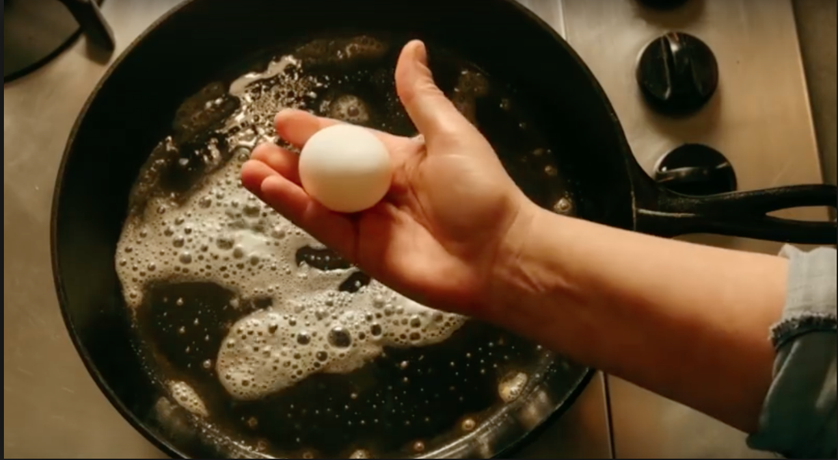

Slide 5
Sunday’s Coming!
Are you ready?

Slide 8
Is it worth it?

Slide 9
So Many Responsibilities
Curriculum (Large Group & Small Group)
Resources (Large Group & Small Group)
Production Elements (Presentation, Rehearsal)
Environment/Set Design
Volunteers (Scheduling, Communication, Preparation)

Slide 10
So Many MORE Responsibilities
Huddles
Leadership Development
Volunteer Assimilation
Partnering with Parents
Social Media

Slide 11
Even MORE Responsibilities
Events
Pastoral Care
Shopping
Volunteer Troubles
LIFE!

Slide 12
GETTING IT ALL DONE!
3 Tips for Preparing Effectively
…and staying sane in the process!

Slide 13
The 3 - I’s
Institute a Timeline
Implement a Rhythm
Invite Others to Join You

Slide 14
The 3 - I’s
Institute a Timeline
Implement a Rhythm
Invite Others to Join You

Slide 15
INSTITUTE A TIMELINE
Identify all of your responsibilities

Slide 16
RESPONSIBILITIES - SAMPLE LIST

Slide 17
INSTITUTE A TIMELINE
Identify all of your responsibilities
Determine a start date by backing up 8 weeks from your due date (any given Sunday)

Slide 18
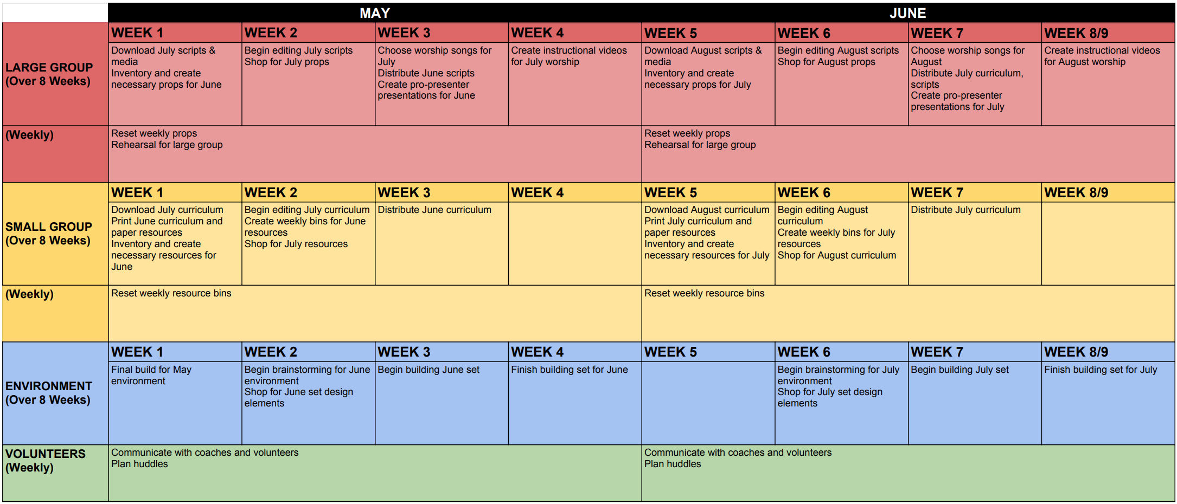

Slide 19
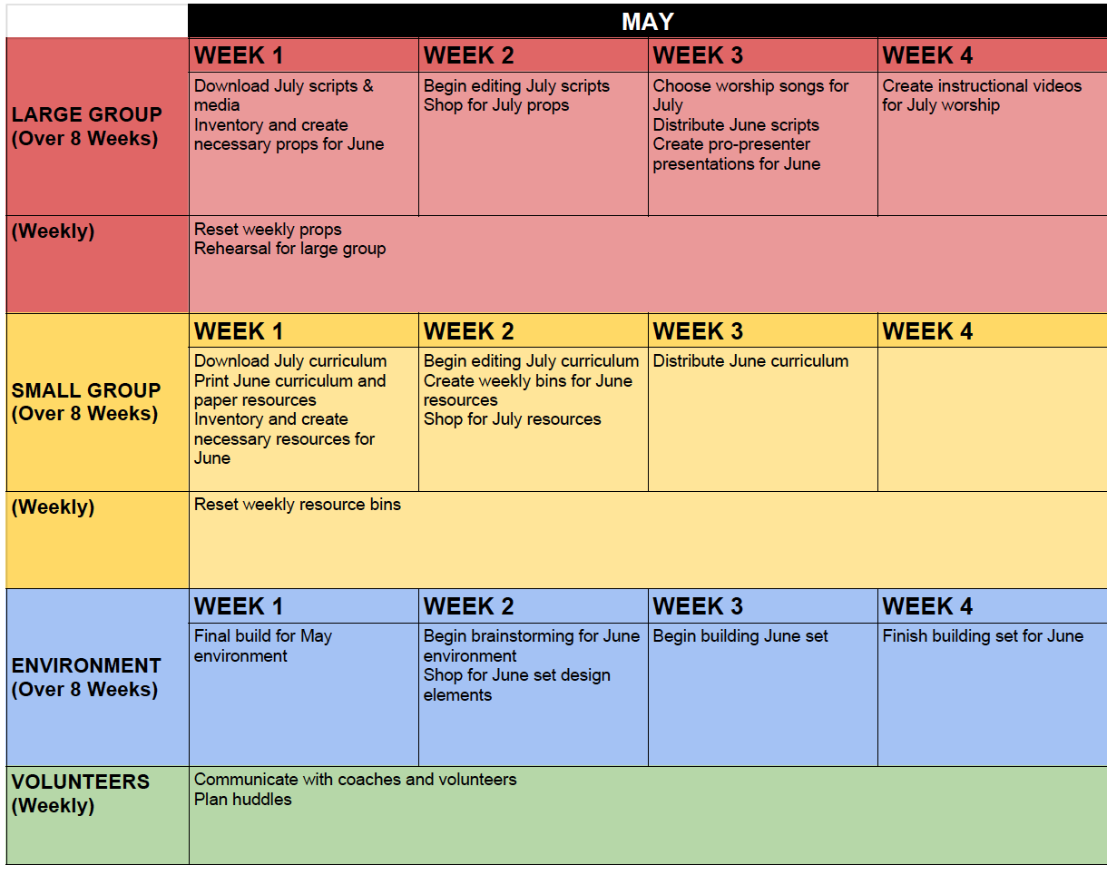

Slide 20
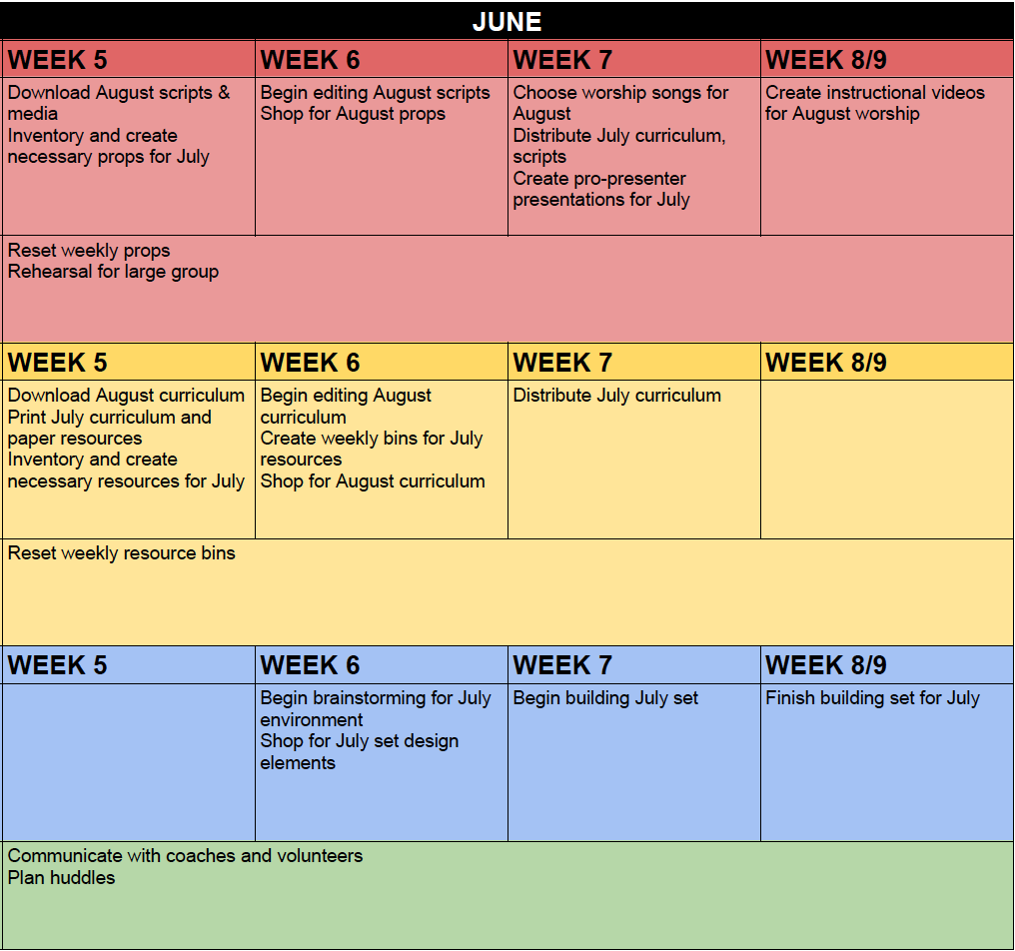

Slide 21
The 3 - I’s
Institute a Timeline
Implement a Rhythm
Invite Others to Join You

Slide 22
IMPLEMENT A RHYTHM
Create a weekly schedule - begin with fixed elements (i.e. meetings, service times, etc.)
Determine work blocks (times you are free to work on Sunday responsibilities)
Place responsibilities from timeline into open work blocks

Slide 23
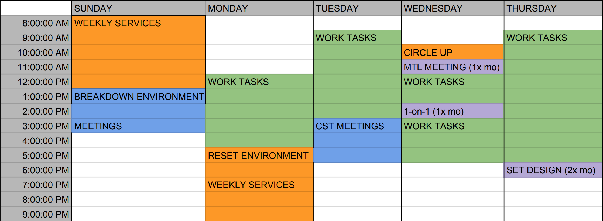
SAMPLE WEEKLY RHYTHM

Slide 24
The 3 - I’s
Institute a Timeline
Implement a Rhythm
Invite Others to Join You

Slide 25
BARRIERS TO INVITING
1. Not organized/prepared enough to hand things off
2. Don’t want to burden other
3. Fear of resistance/rejection

Slide 28
INVITE OTHERS TO JOIN YOU
Review your list of responsibilities and identify what you can hand off:
What drains you?
What do you wish you didn’t have to do?
What will free you to focus on what you are best at?
Who on your team has a passion/potential for something in particular?
Start with one person who can continue in their Sunday role, but also can take on more ownership/responsibility
Then find another person... and then another… and another…

Slide 29
WHY BOTHER?
A team doing this is always better than just you:
You won’t feel crazy – you will have peace
Others get to be a part of this great work God has given us
You won’t miss moments

Slide 30
Being prepared in advance allows us to be present in the moment.

Slide 31
#OPERATIONSUNDAYSCOMING

