Slide 1
HOW DO I DESIGN BETTER
ENVIRONMENTS FOR KIDS?
LISA MOLITE | @lisamolite

Slide 4
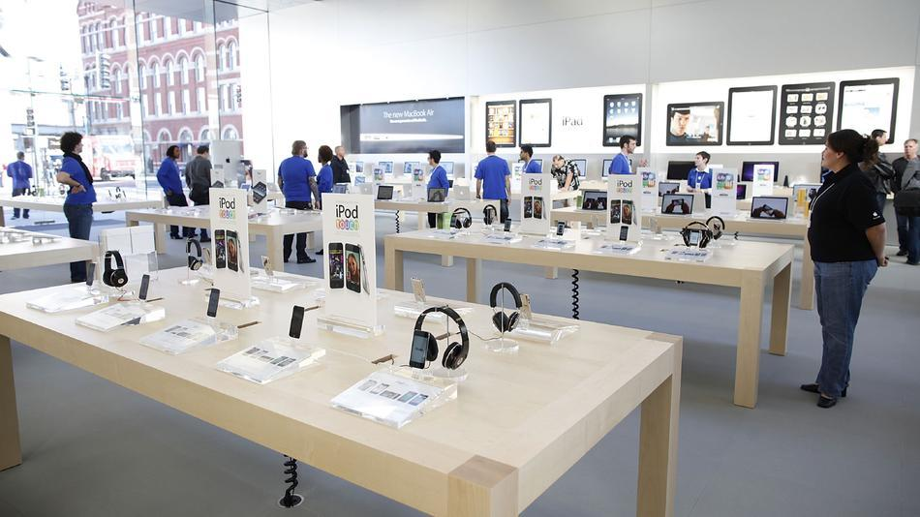

Slide 5
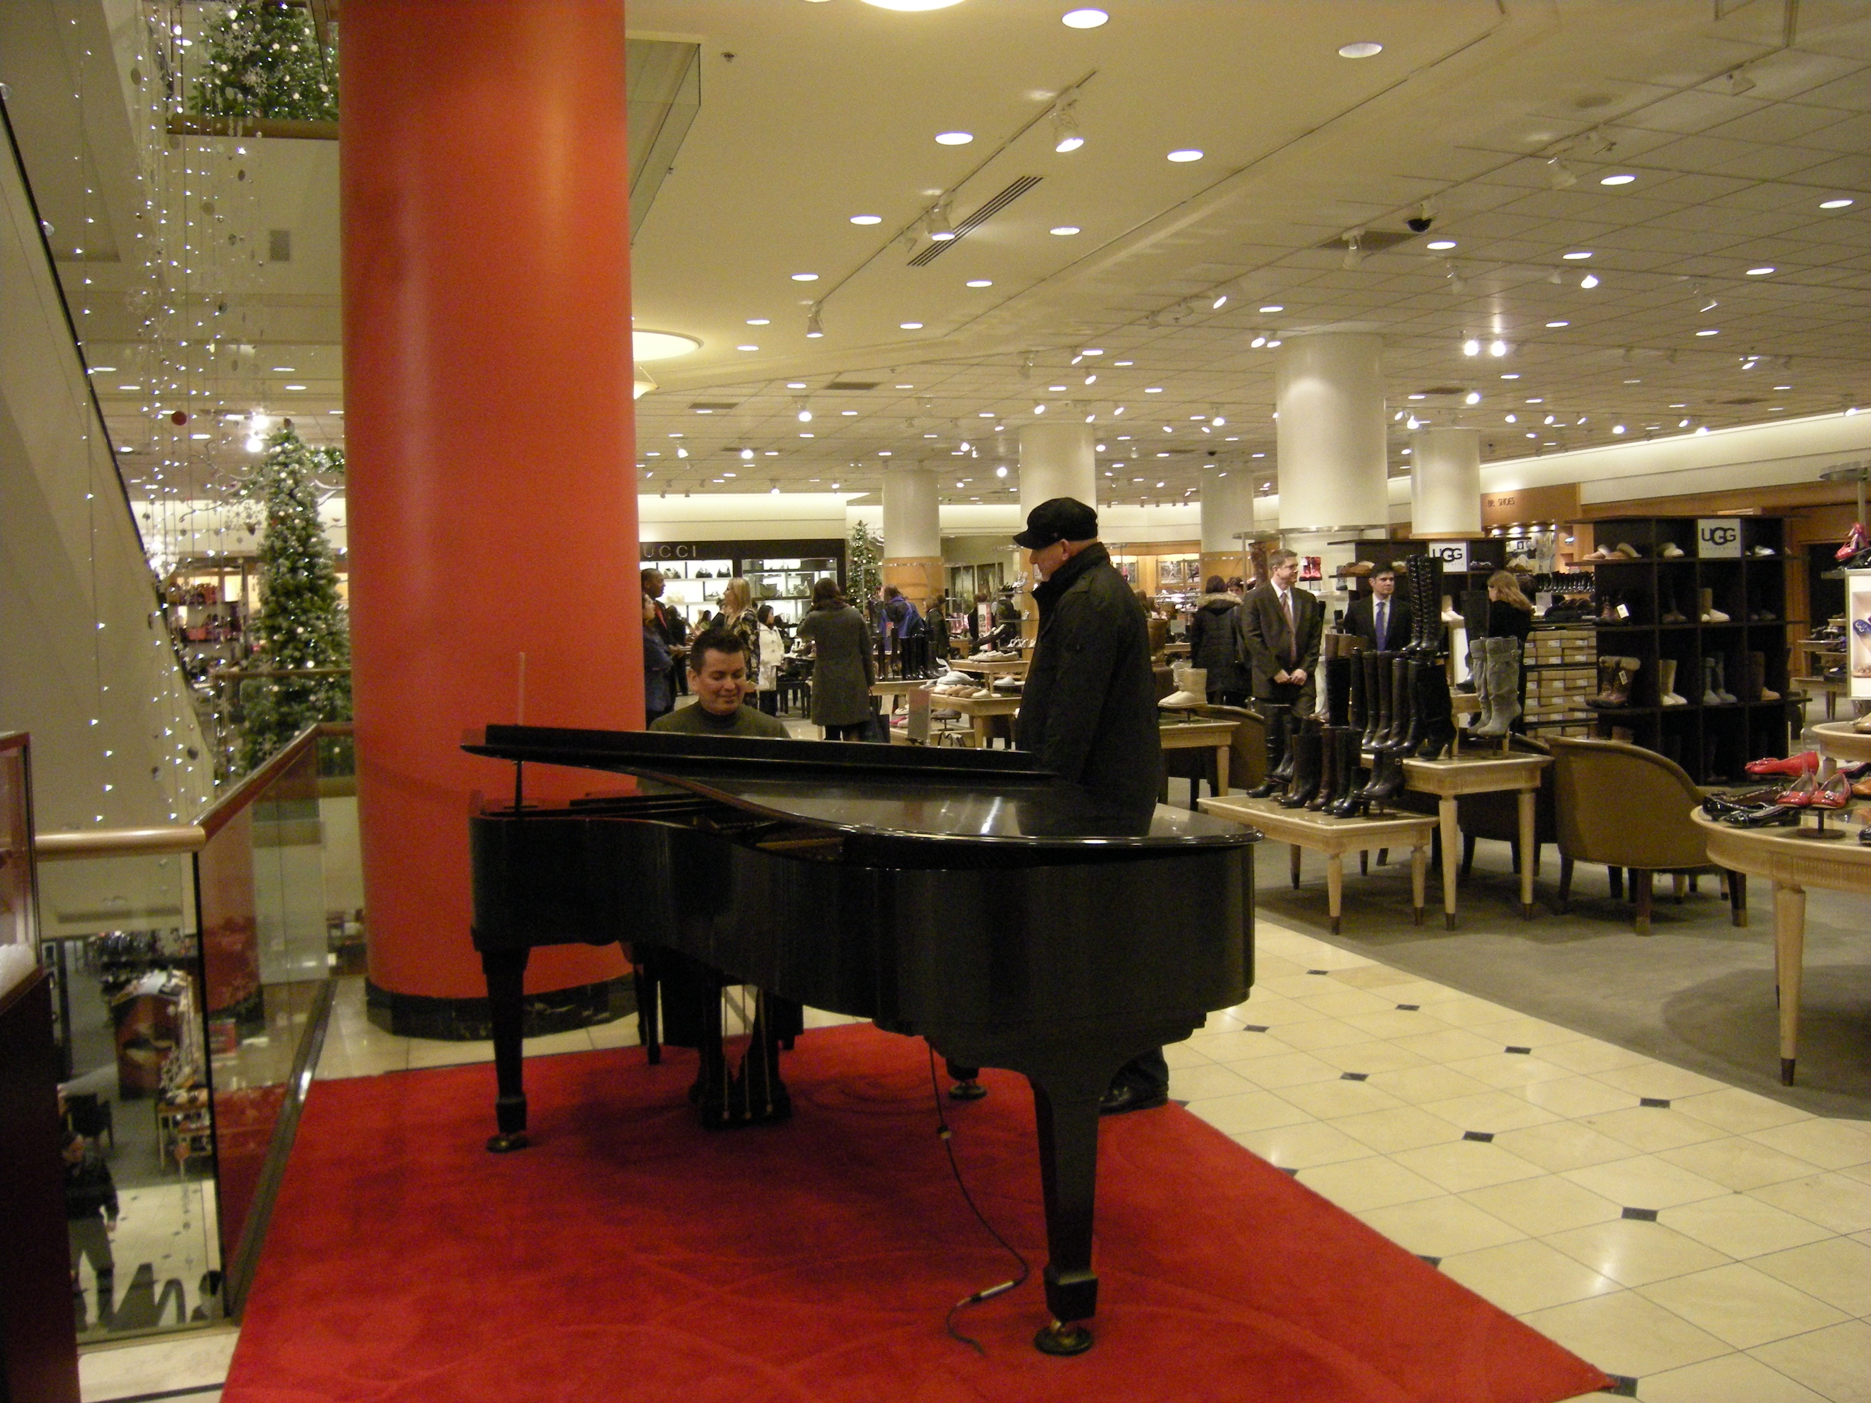

Slide 6
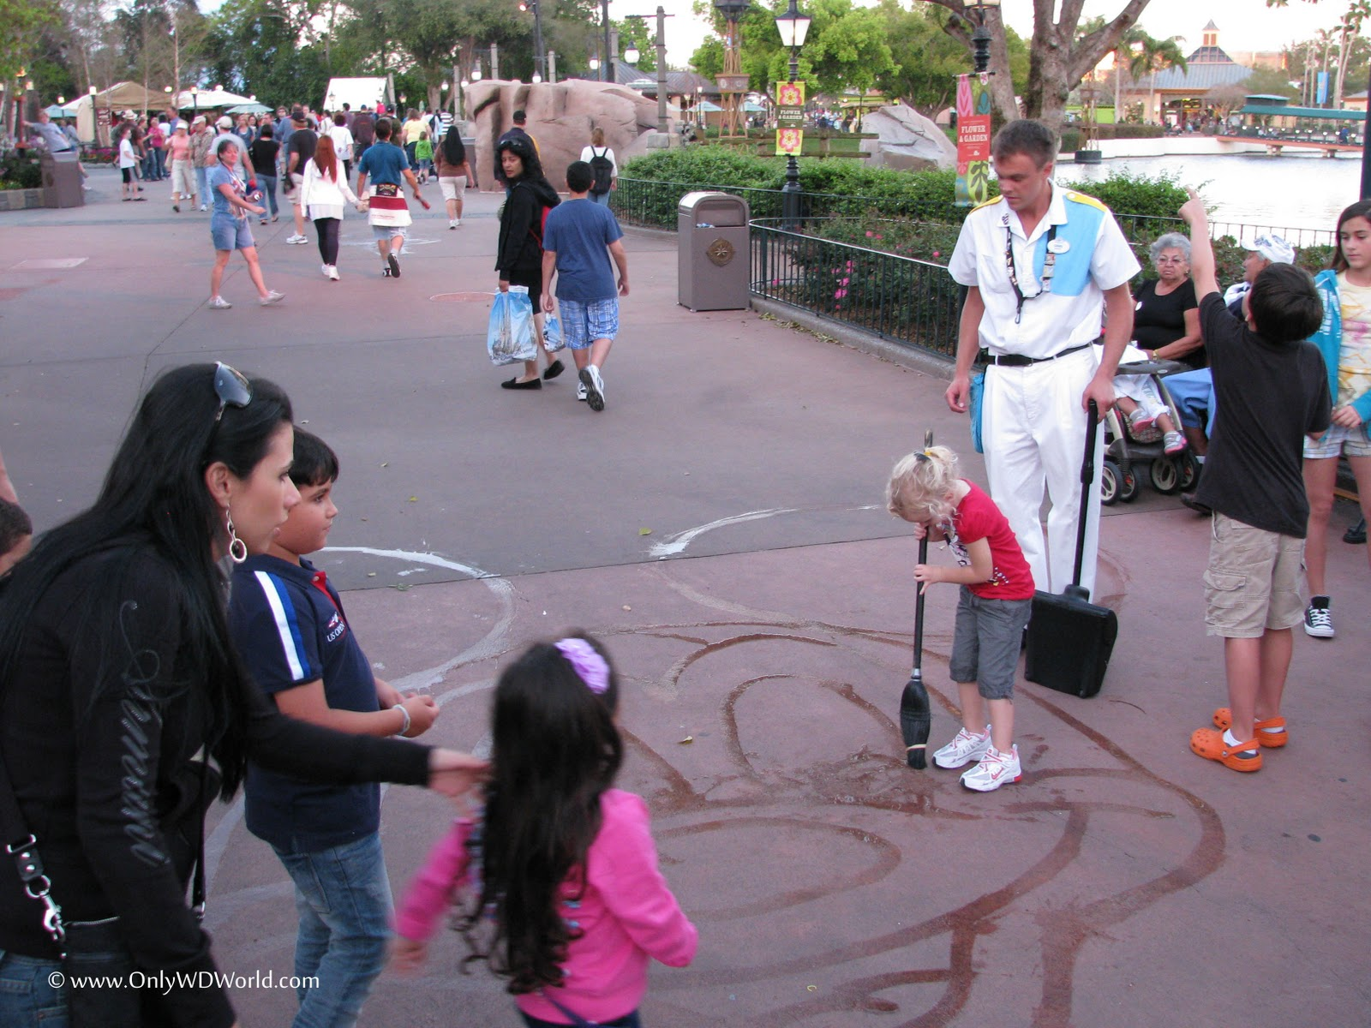

Slide 7
INTENTIONALITY

Slide 8
We are doing more than just creating an environment, we are creating an experience.

Slide 9
We have something better!

Slide 10
Creating an awesome environment is not the end – it’s a means to an end.

Slide 11
The goal of your physical environment is to create a space where relationships can thrive.

Slide 12
BIG 5
Make It Unique
Make It Relevant
Make It Safe
Make It Appealing
Make It Fun

Slide 13
MAKE IT UNIQUE
As much as possible the environments you create should be tailored to the age group using the space.

Slide 14
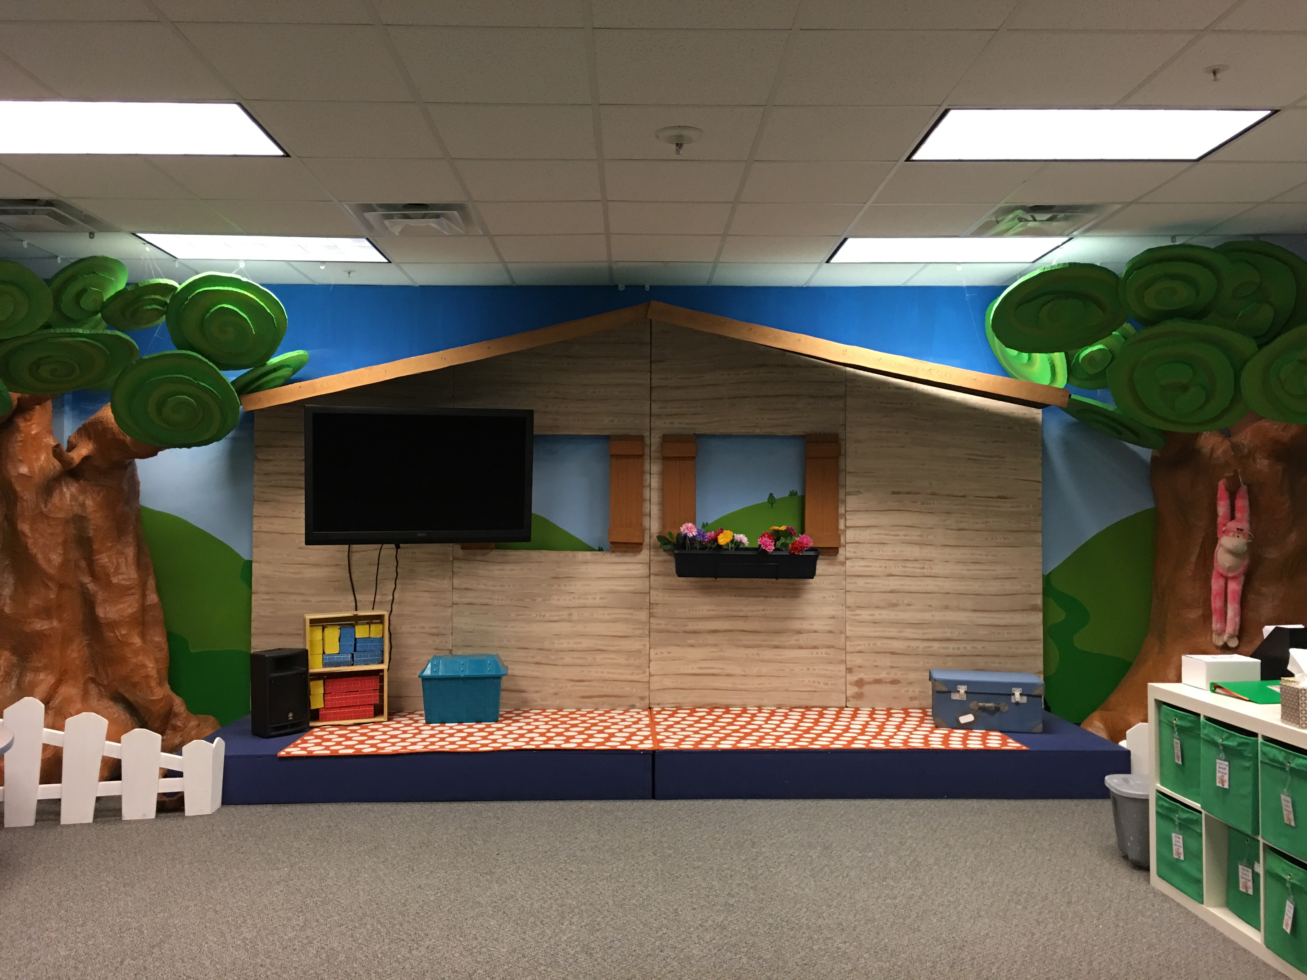

Slide 15
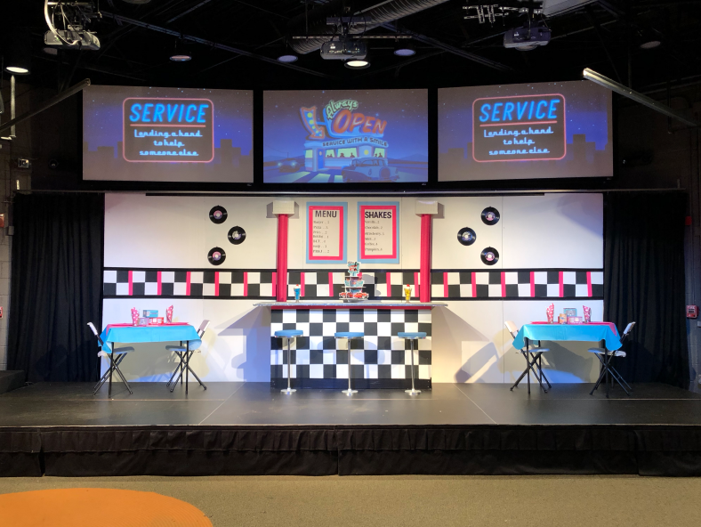

Slide 16
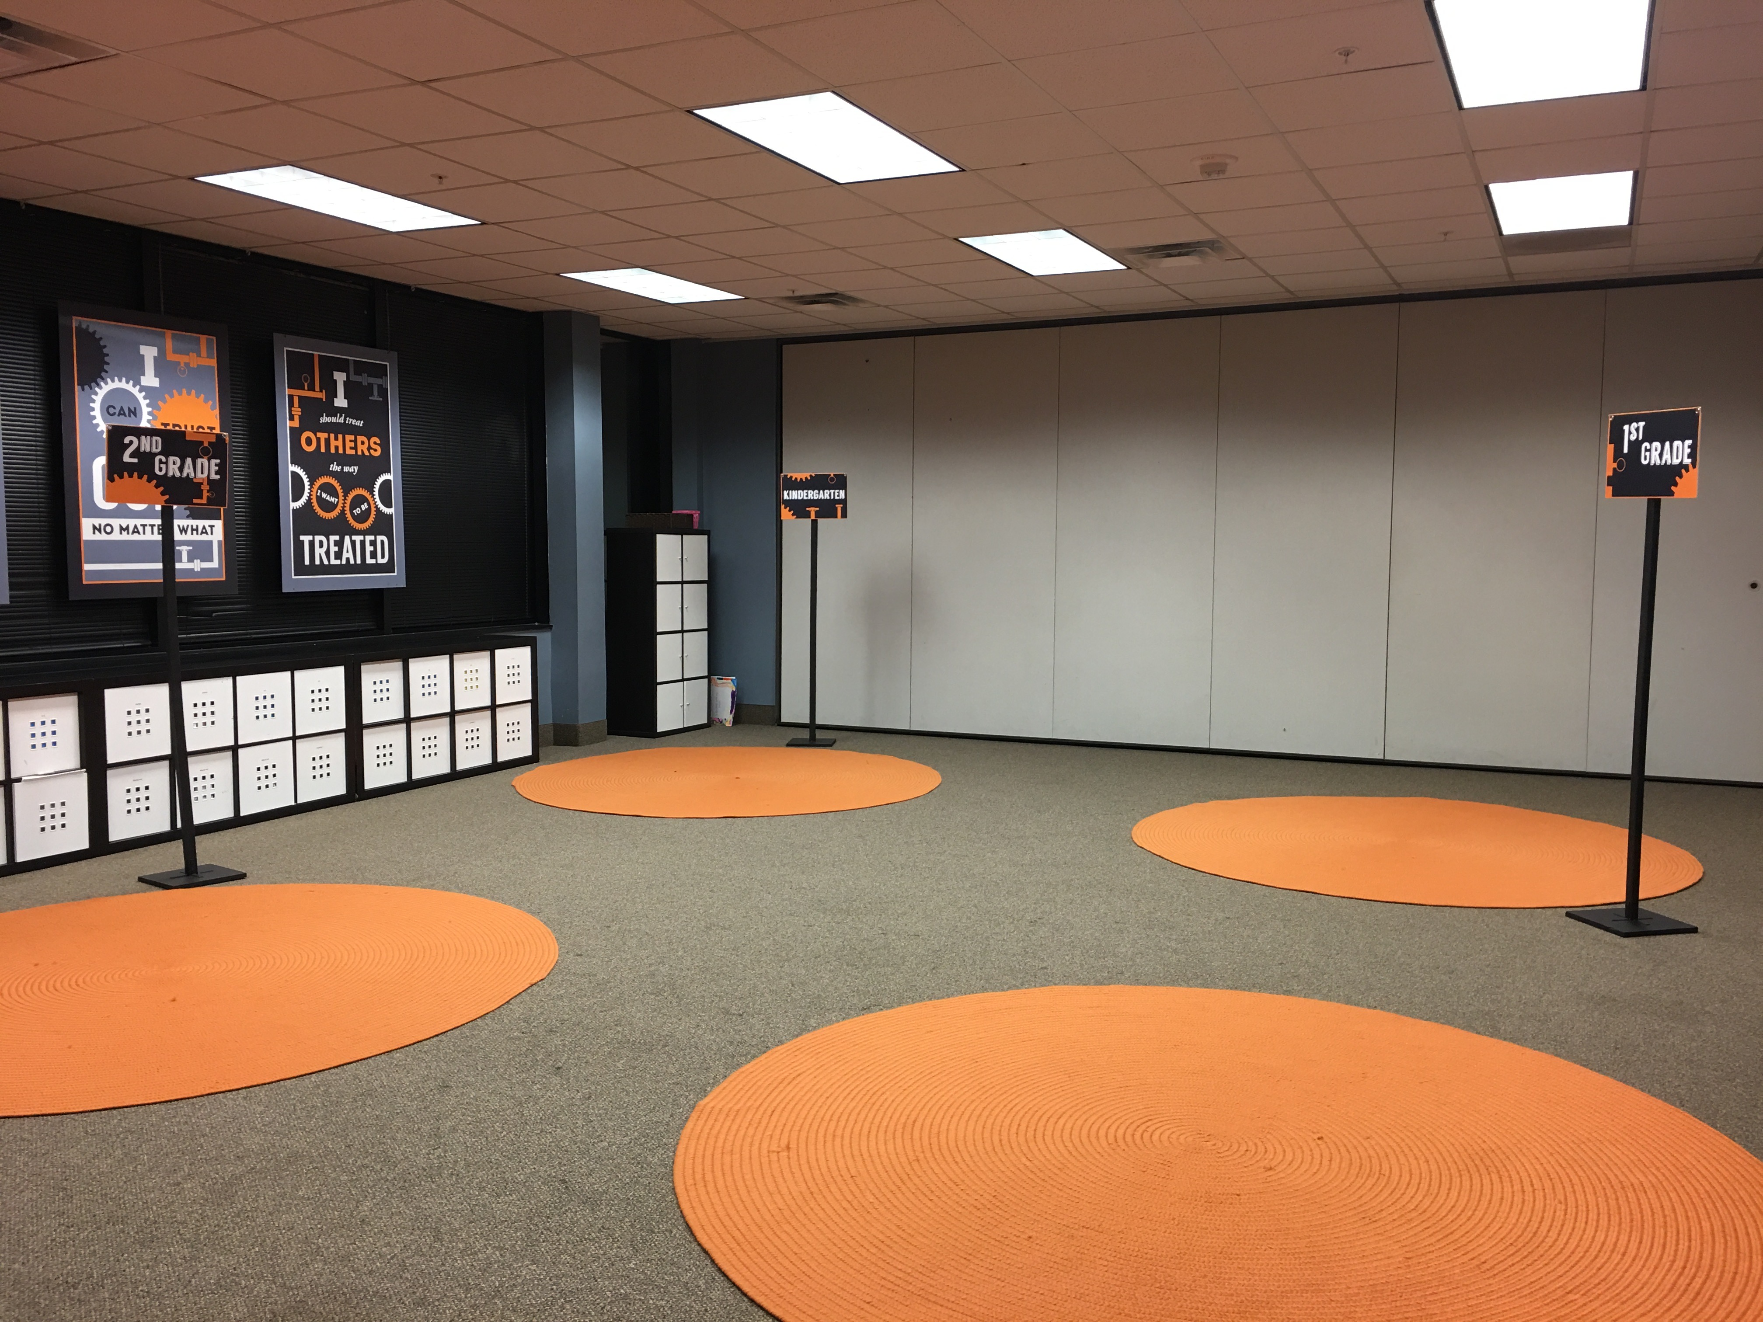

Slide 17
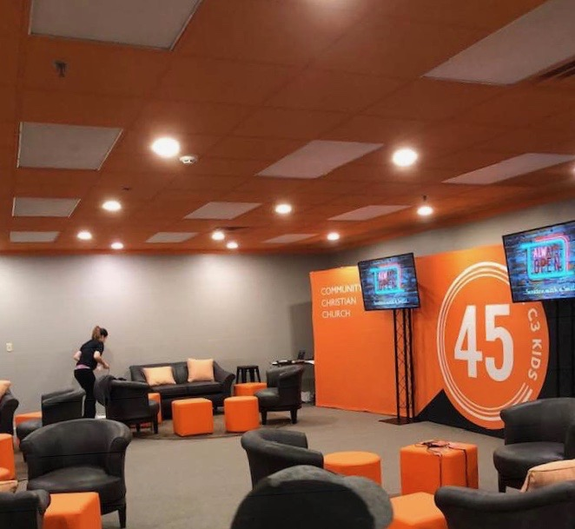

Slide 19
MAKE IT RELEVANT
If it’s 2019 outside, it needs to look like 2019 inside.

Slide 20
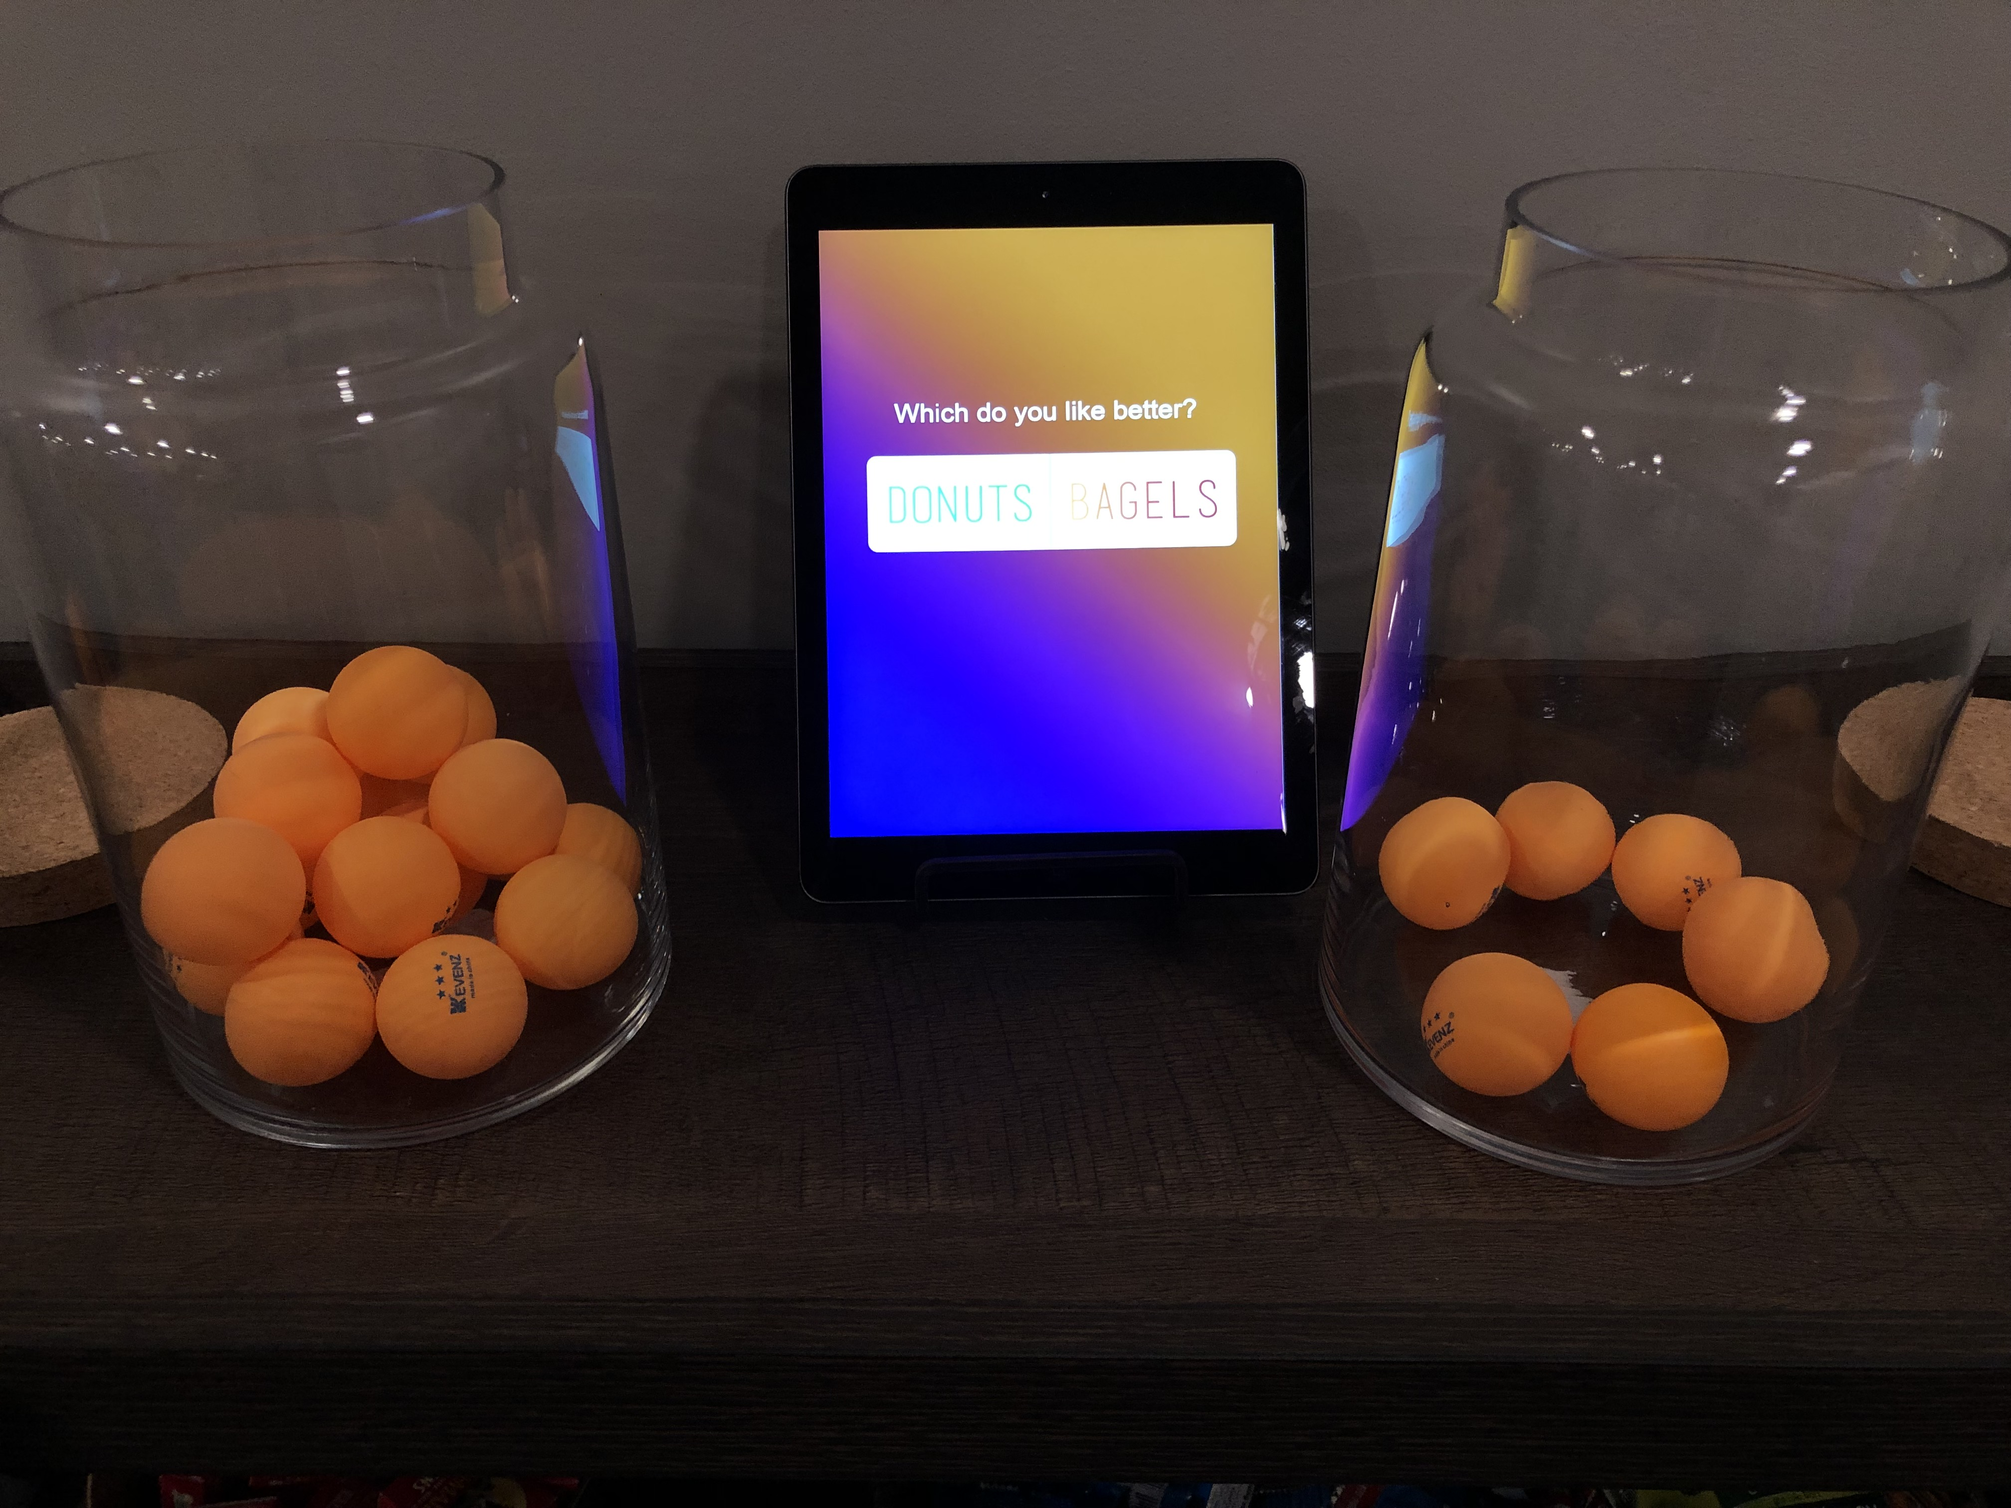

Slide 21
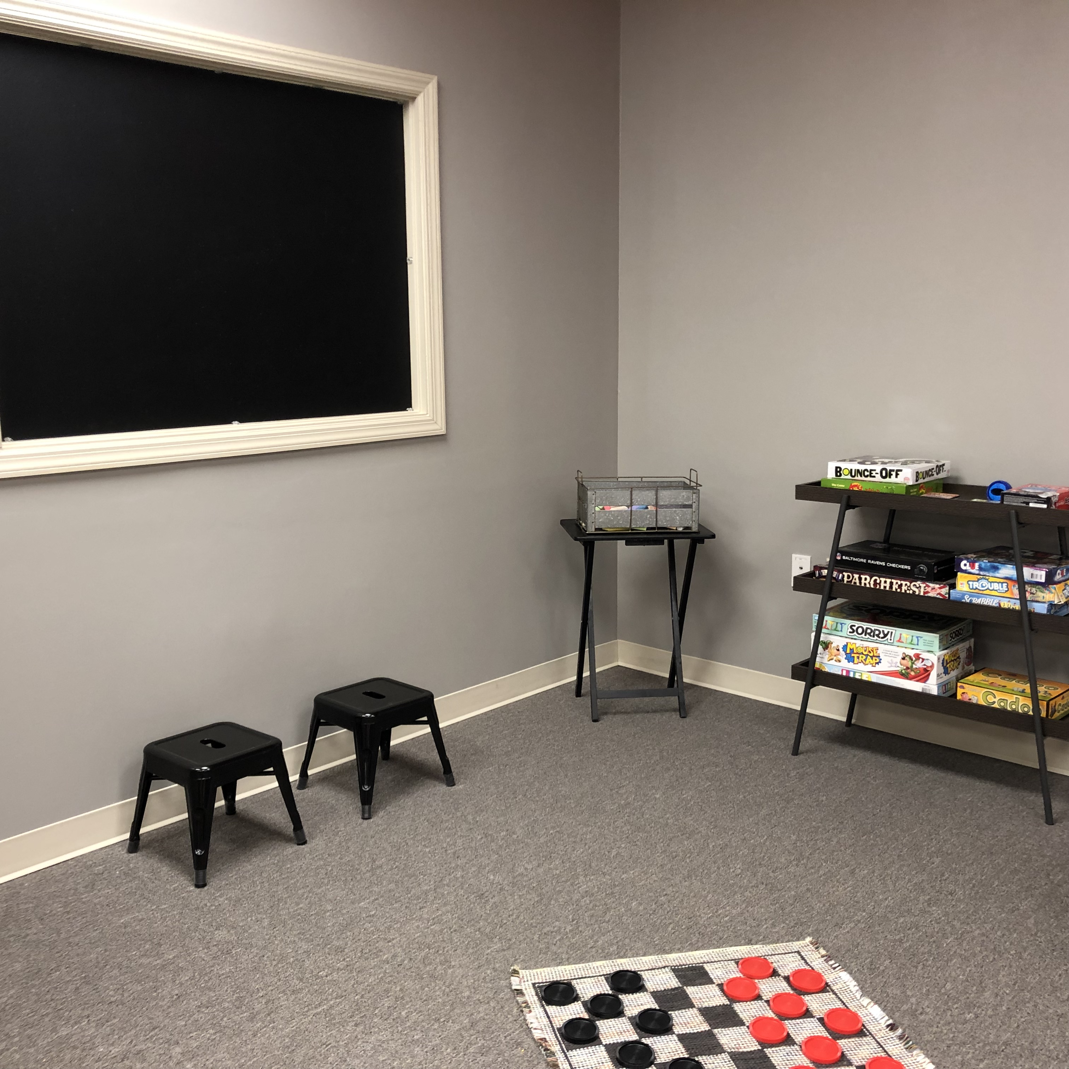

Slide 22
MAKE IT SAFE
Physical Safety
Bathrooms, exits, evacuation plans, ratios, background checks
Emotional Safety
Trusted leaders, Group demographics, a place to belong

Slide 23
MAKE IT APPEALING
Provide extraordinary service
Be organized, keep the space clean
Add intrigue – whatever’s going on, I WANT IN!
Be predictably - unpredictable

Slide 24
MAKE IT FUN
Fun makes a child comfortable
Fun makes a child want to come back
Fun earns a child’s trust

Slide 25
MAKE IT FUN - HOW
Games
Out of the box activities
Surprise gifts, snacks
Décor
Wow factors
Laughter, impromptu moments

Slide 26
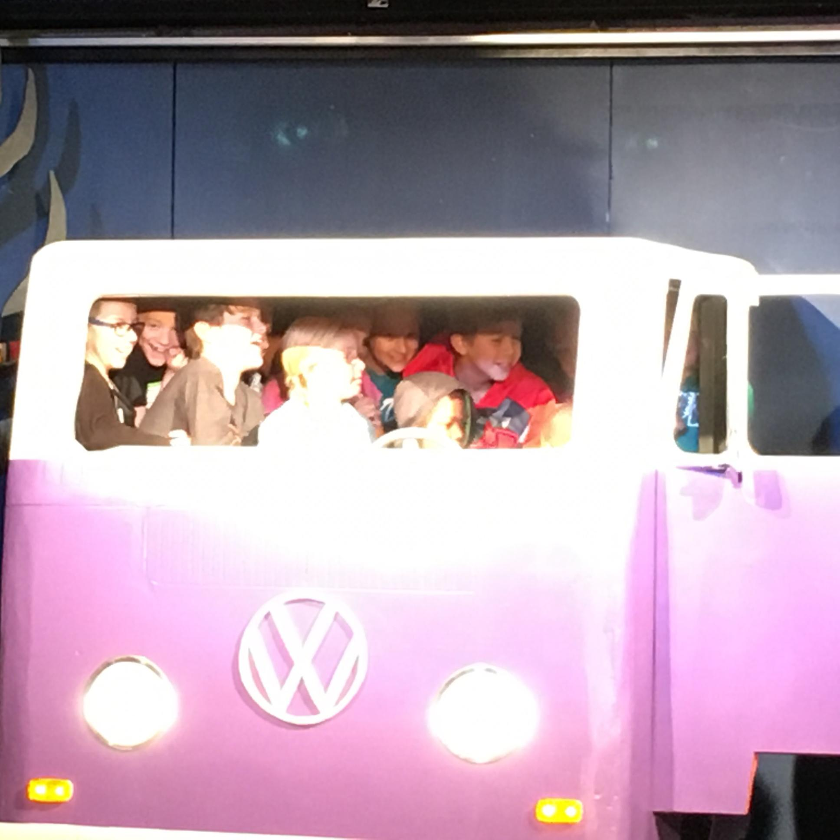
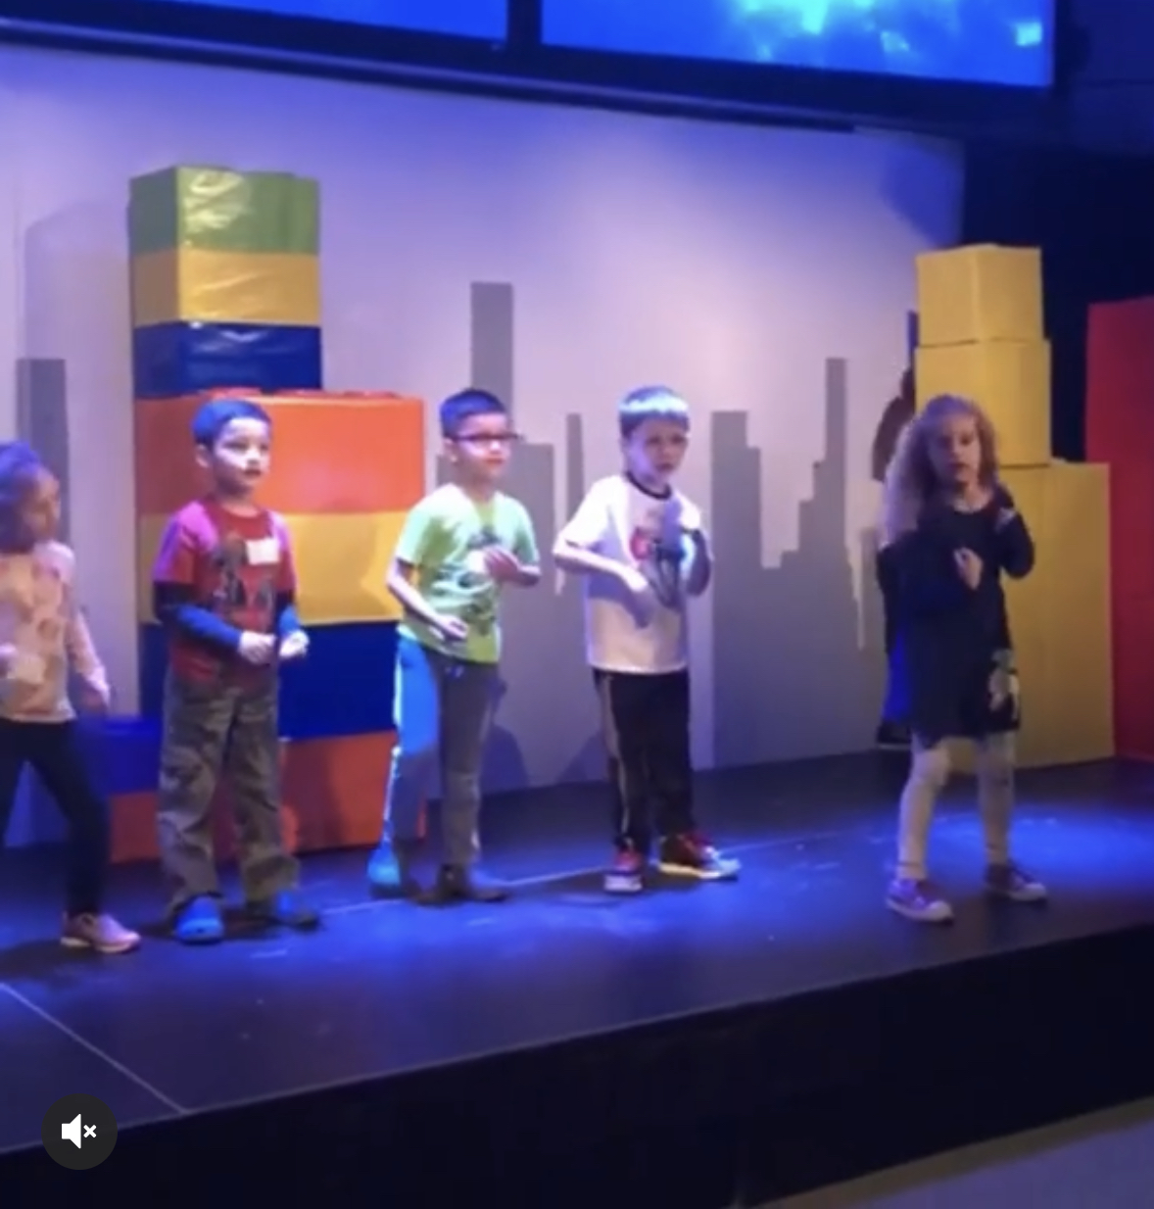

Slide 27
NUTS & BOLTS
Décor
Shared Spaces

Slide 28
DÉCOR
Static Sets
Themed Environments
Changing Themes

Slide 29
DÉCOR
Static Sets
Themed Environments
Changing Themes

Slide 31
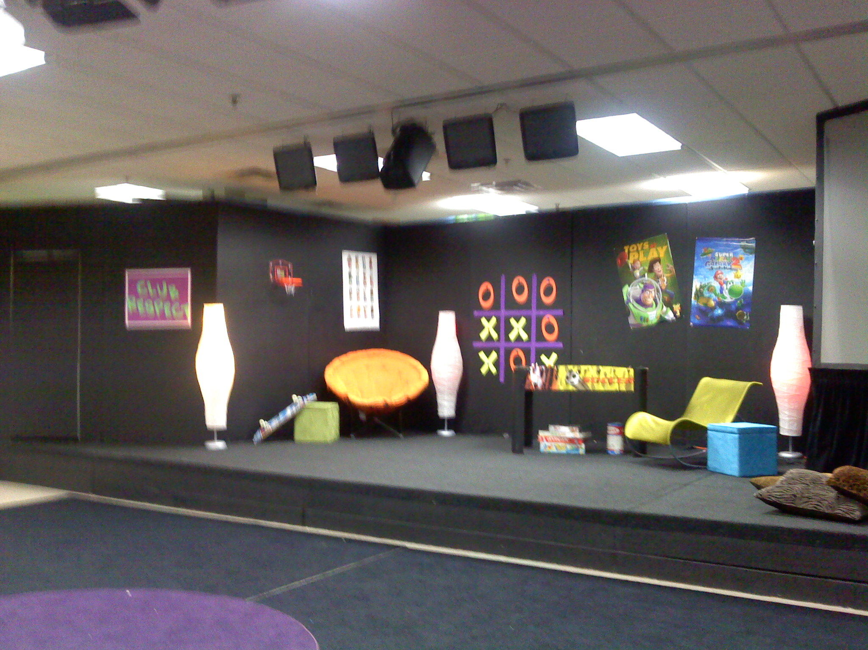
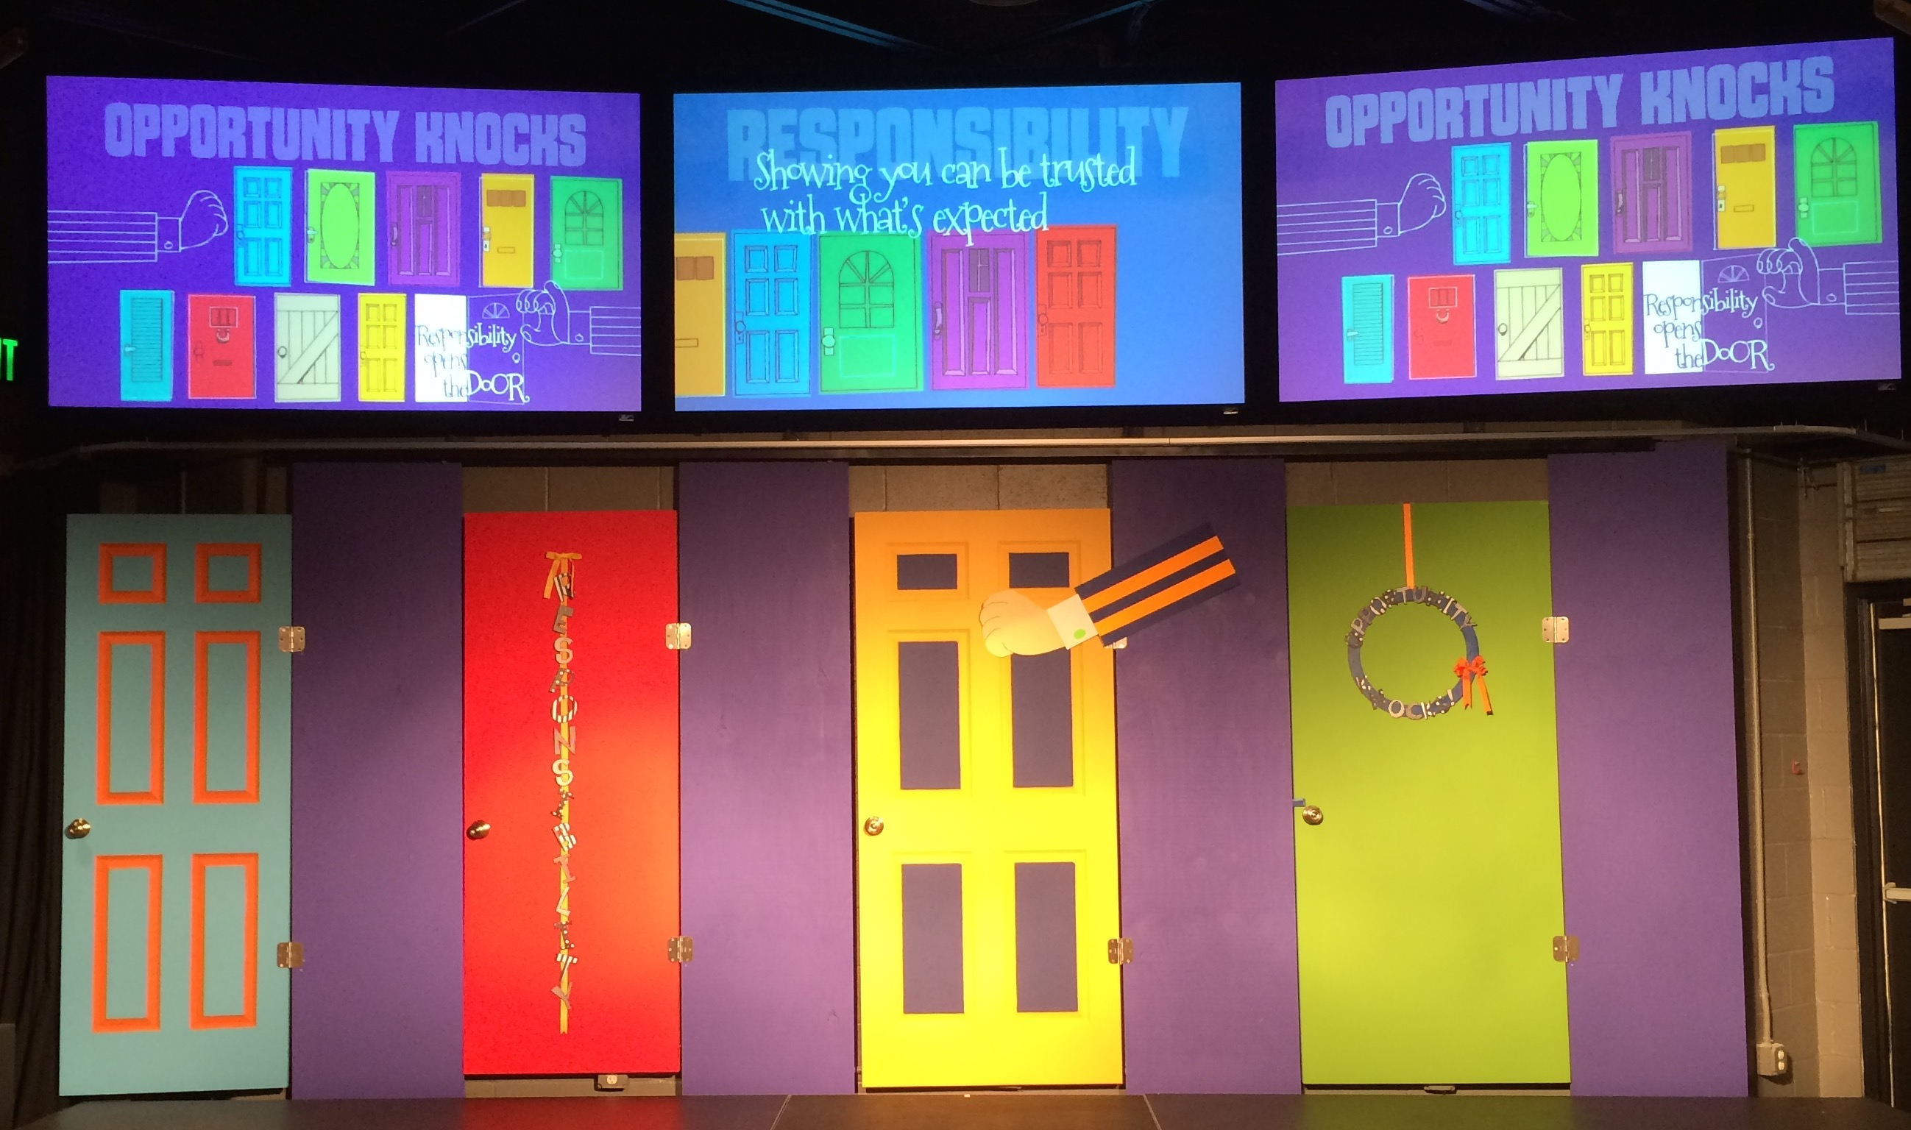

Slide 32
DÉCOR
Static Sets
Themed Environments – FYI!
Changing Themes

Slide 33
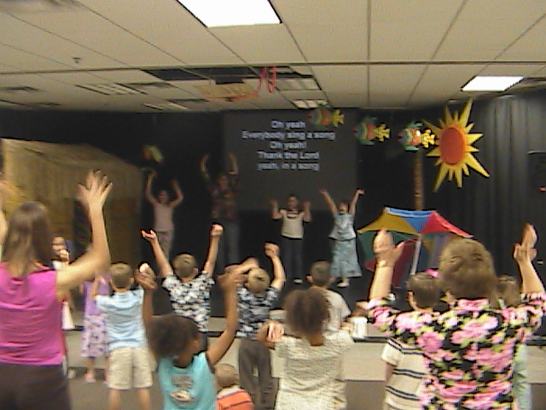
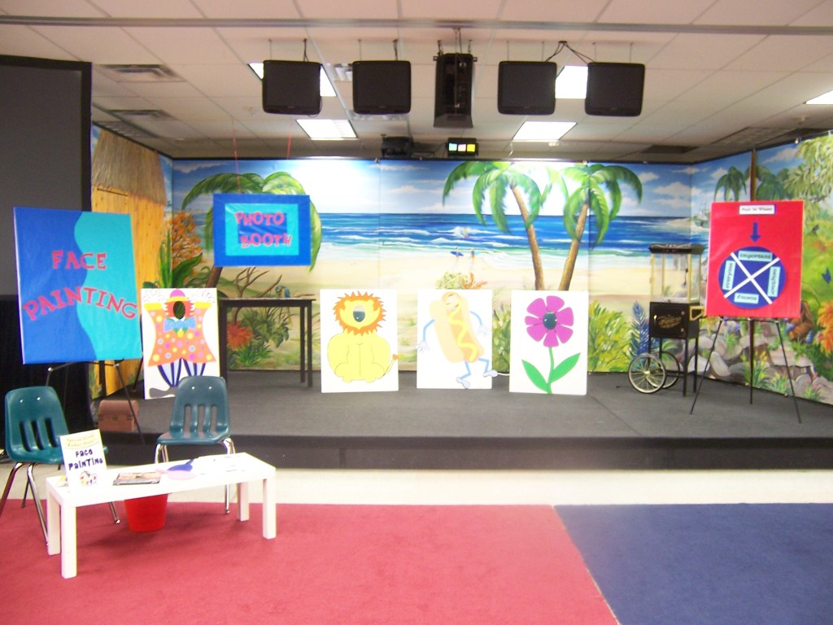

Slide 34
DÉCOR
Themed Environments
Static Sets
Changing Themes – my favorite!

Slide 35
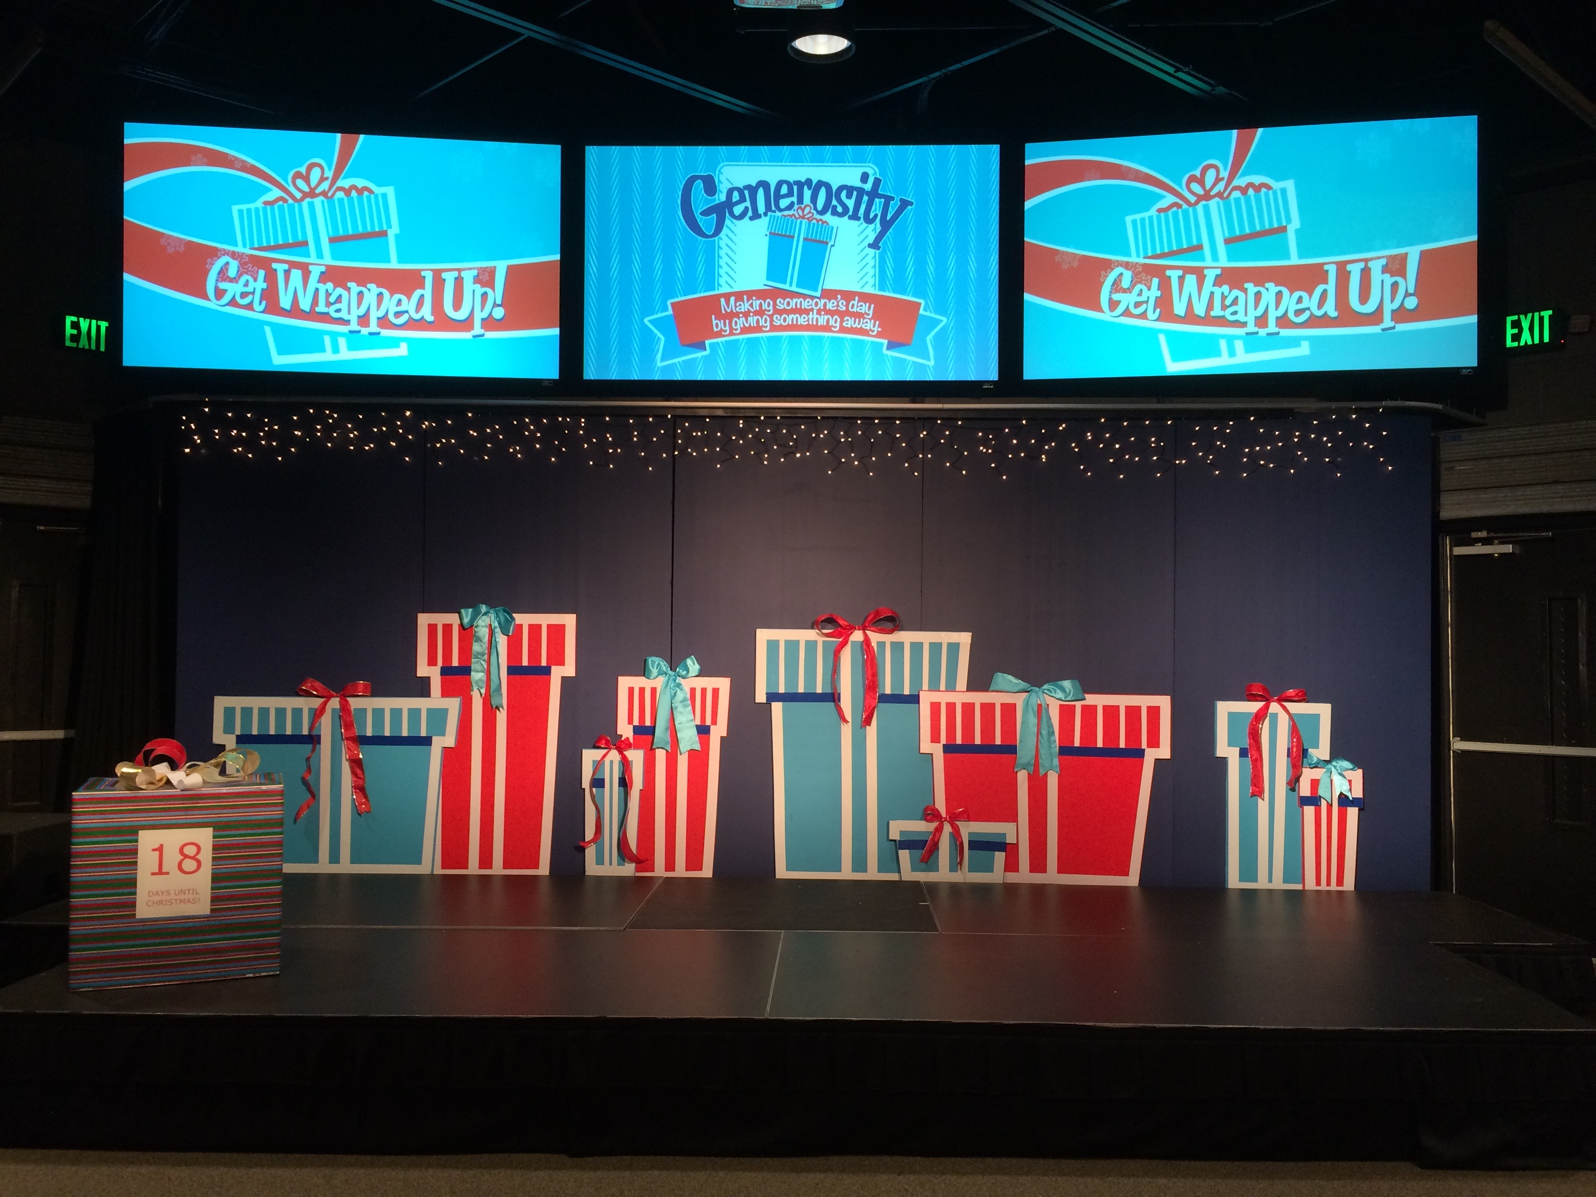

Slide 36
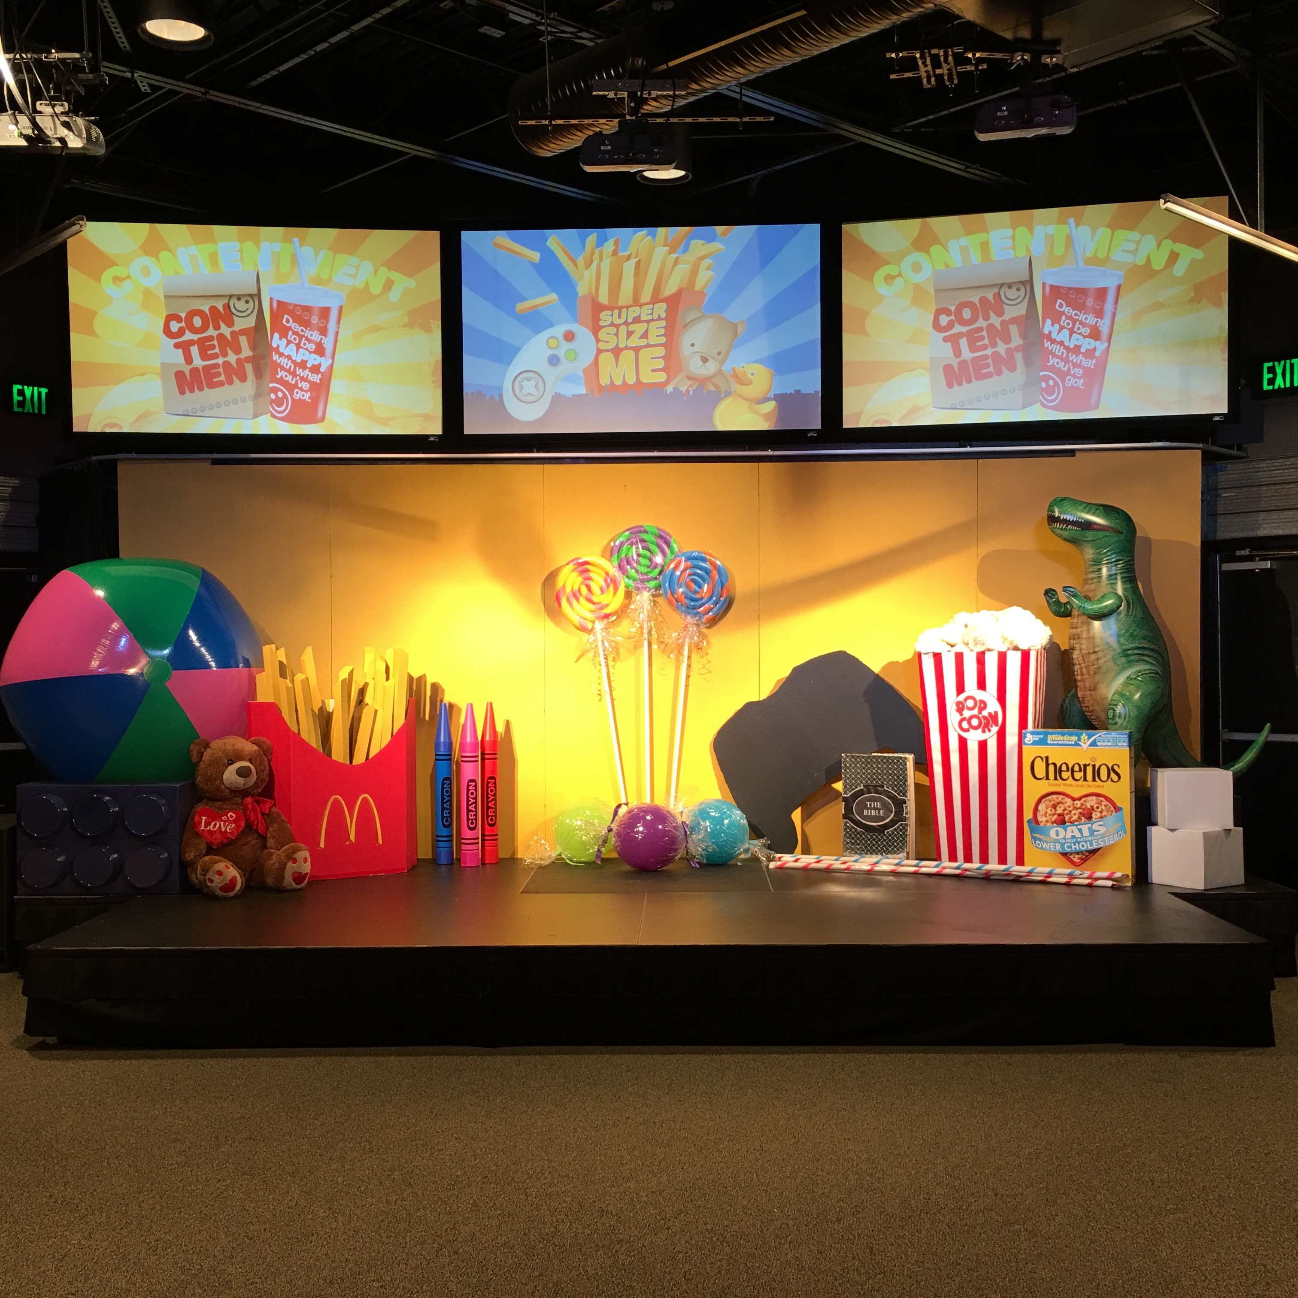

Slide 37
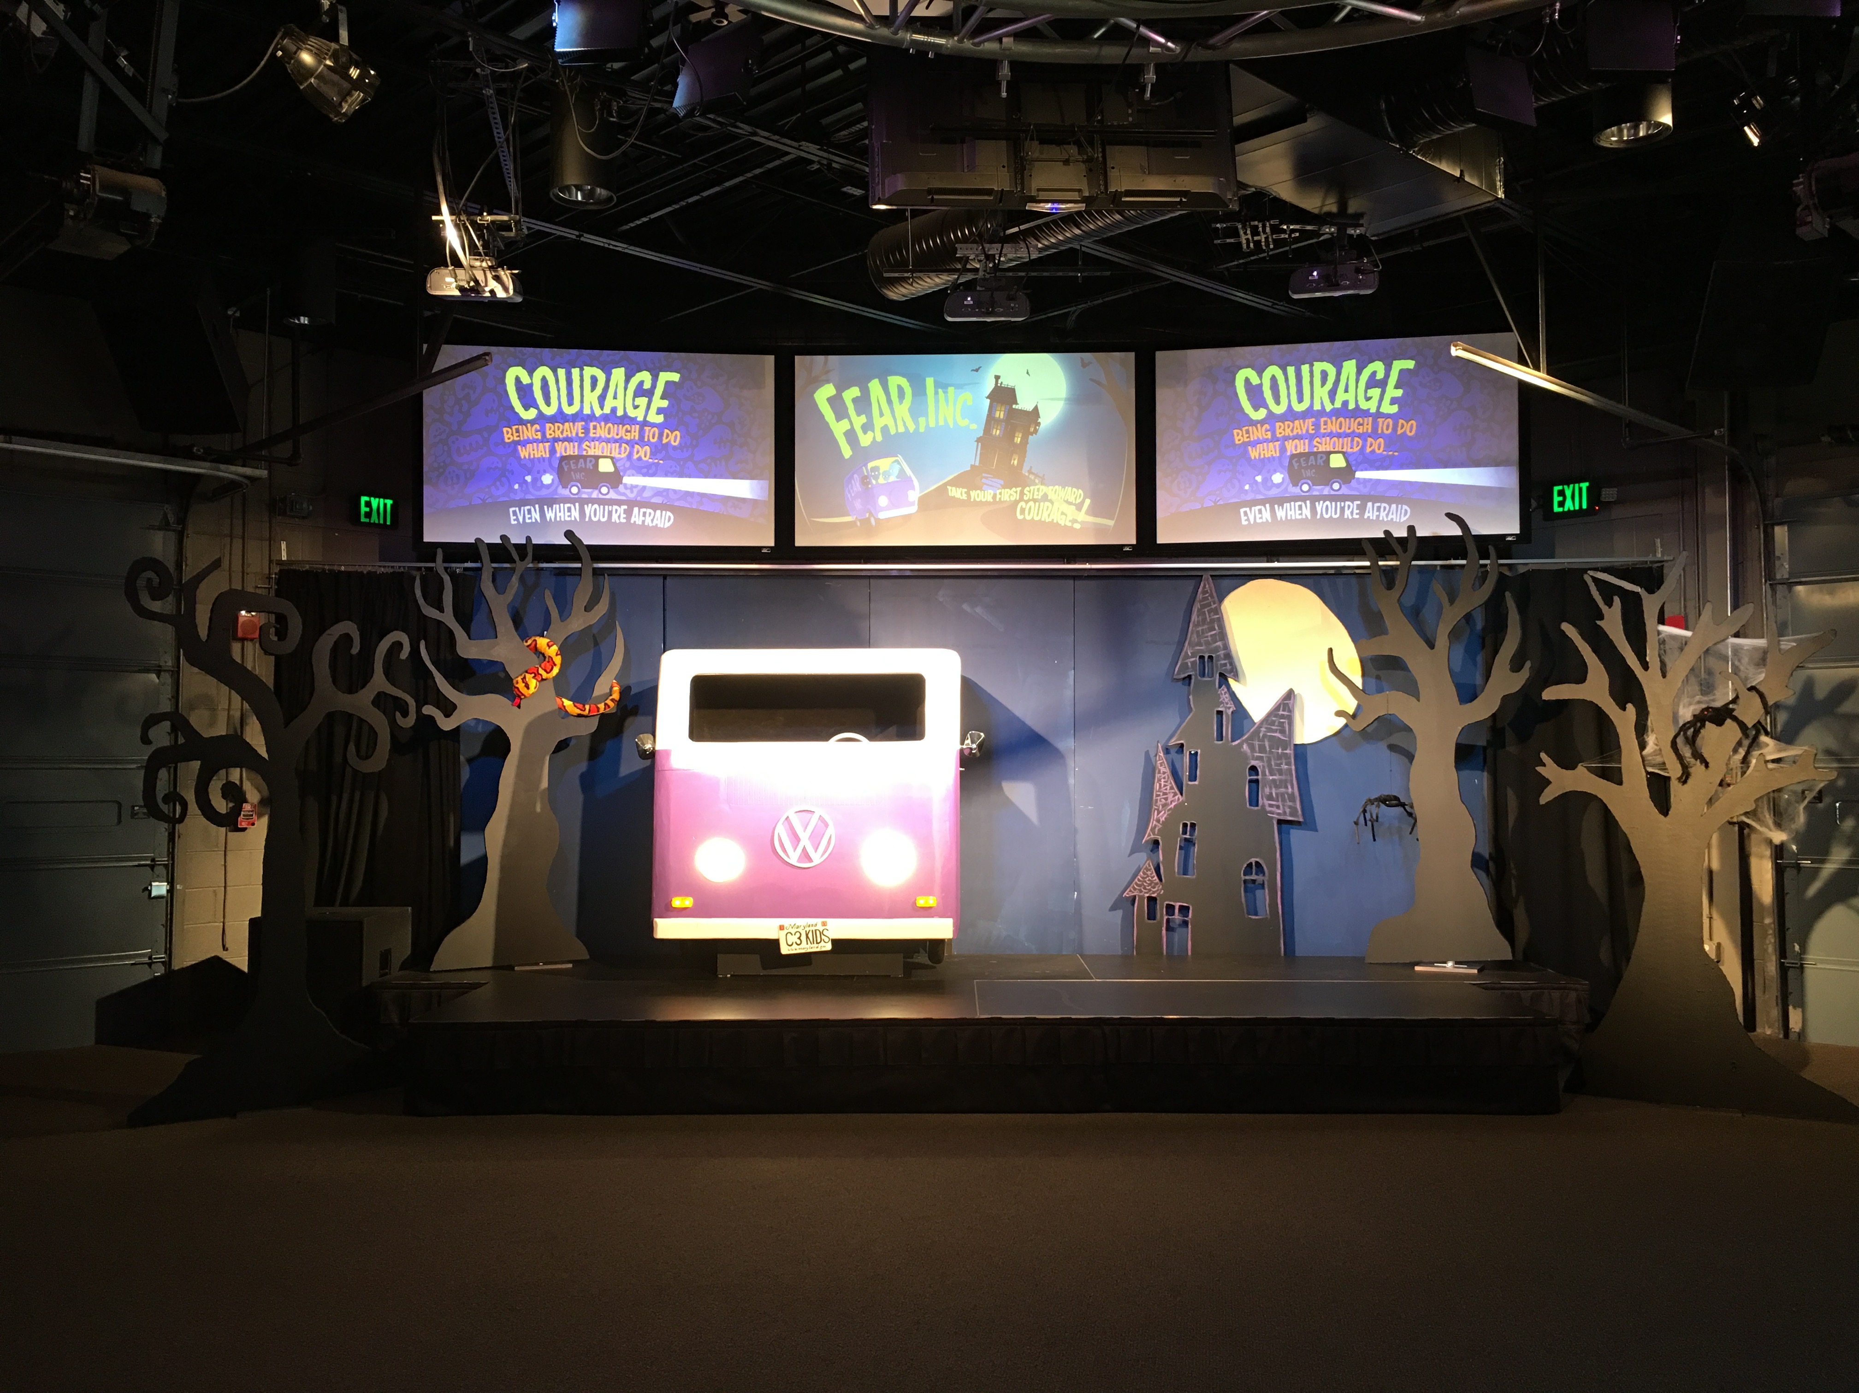

Slide 38
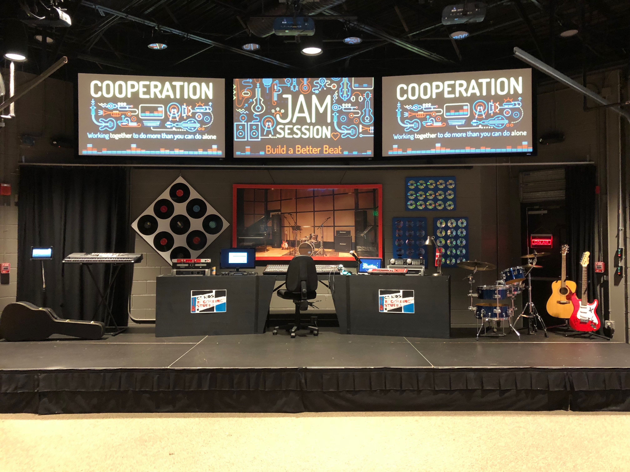

Slide 39
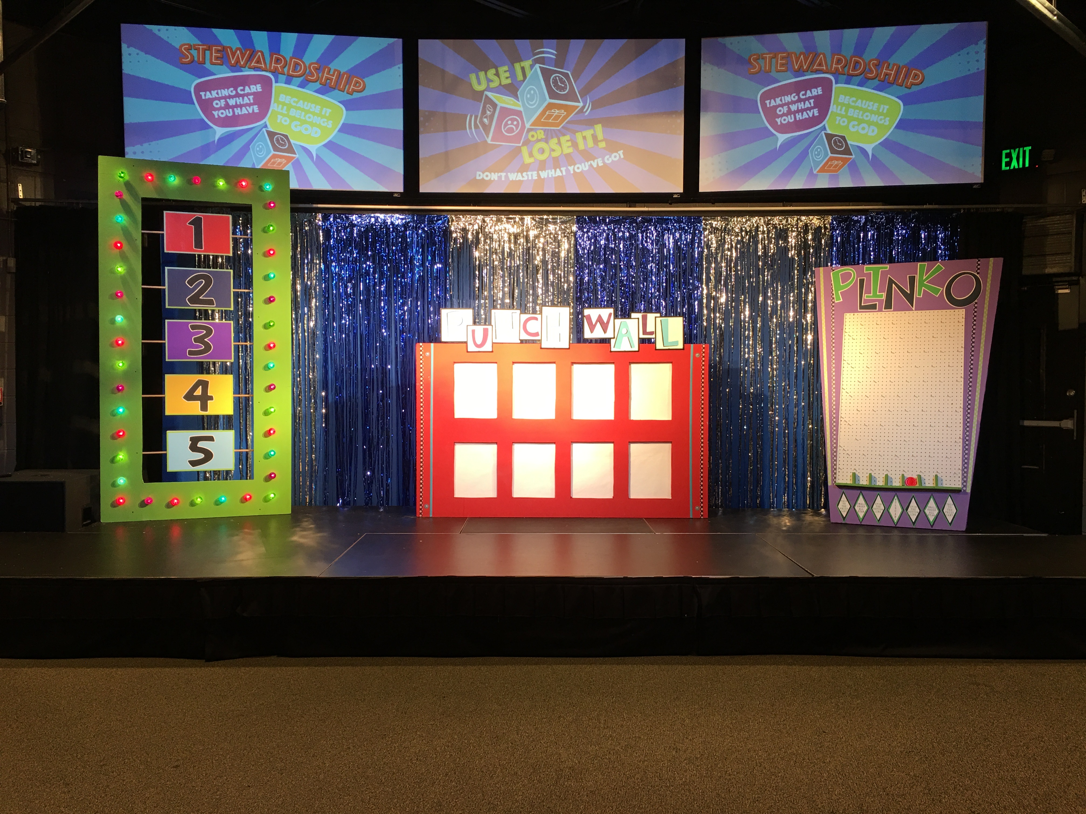
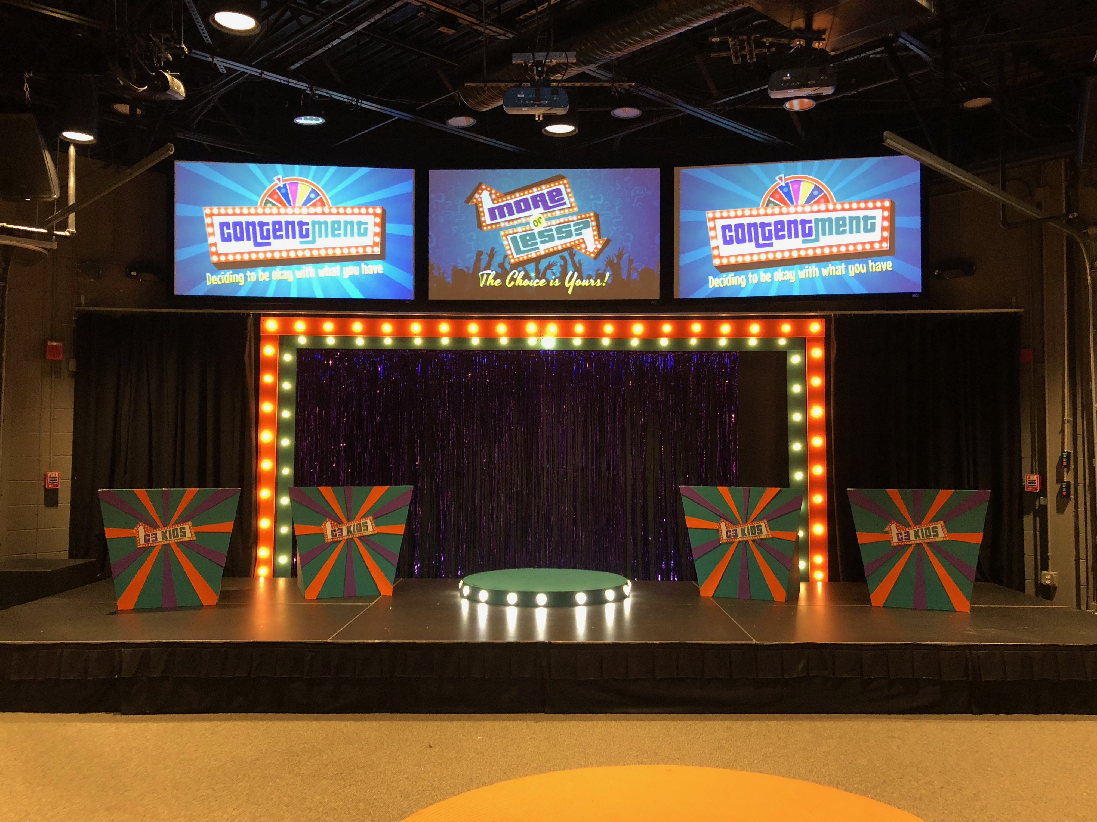

Slide 40
DÉCOR
Create a Focal Wall
Use Light & Color

Slide 41
DÉCOR – FOCAL WALL
Insulation Foam Backdrops
Pipe & Drape
Banners
Chalkboard/Whiteboard
Projection Screens

Slide 45
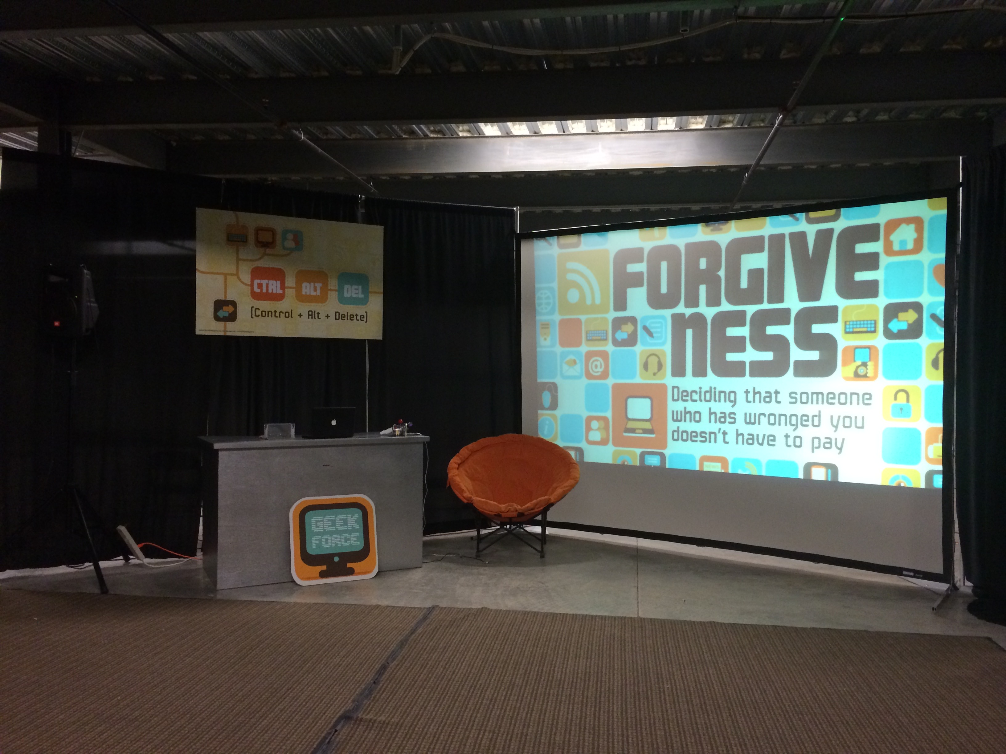

Slide 46
DÉCOR – Helpful Tools
Insulation Foam
Hot Knife or Jigsaw
T-Square
Sharp box cutters/x-acto knives
Paint
T-Pins
Projector

Slide 47
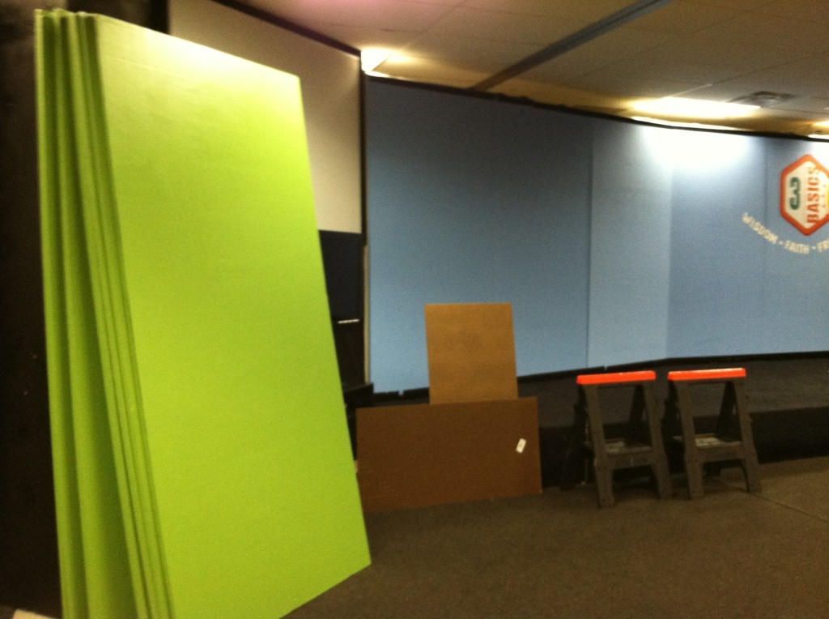
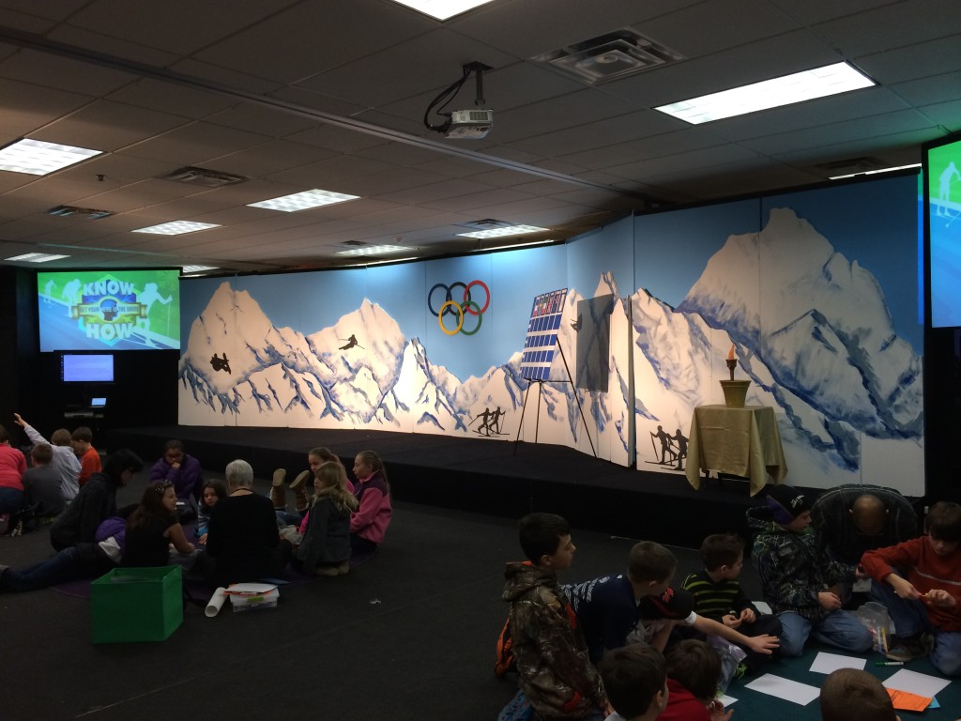

Slide 48
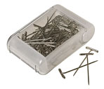

Slide 49
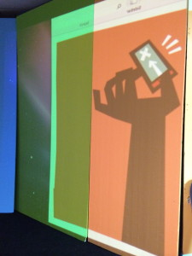
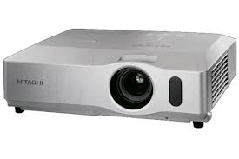

Slide 50
DÉCOR
Create a Focal Wall
Use Light & Color

Slide 51
DÉCOR – COLOR
Brightly colored walls, with large polka-dots or stripes
Key words painted on the walls
Chalk boards with colorful messages
Neutral color scheme with pops of color

Slide 54
DÉCOR – LIGHT
Production Level lighting is awesome, but not always realistic
Truss with light rigs are fun, but again pricey
Lamps with colored bulbs, recessed lighting, light boxes

Slide 55
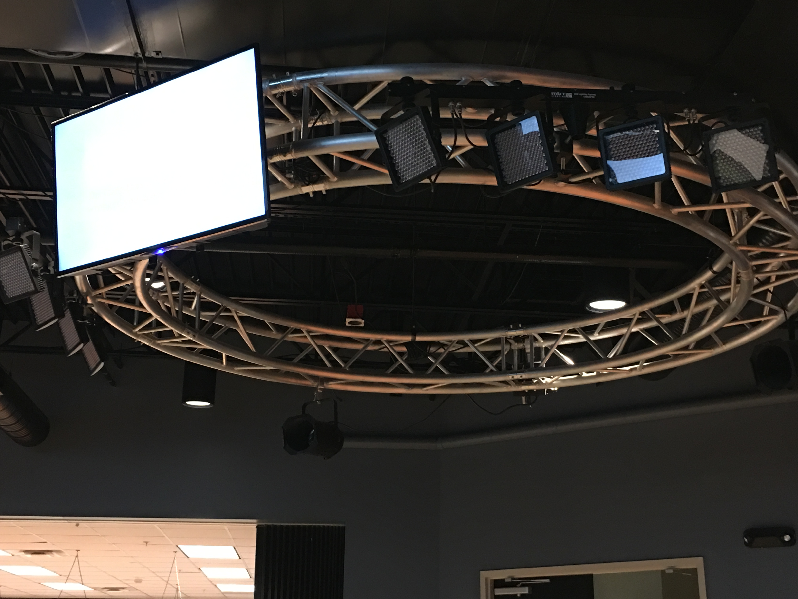
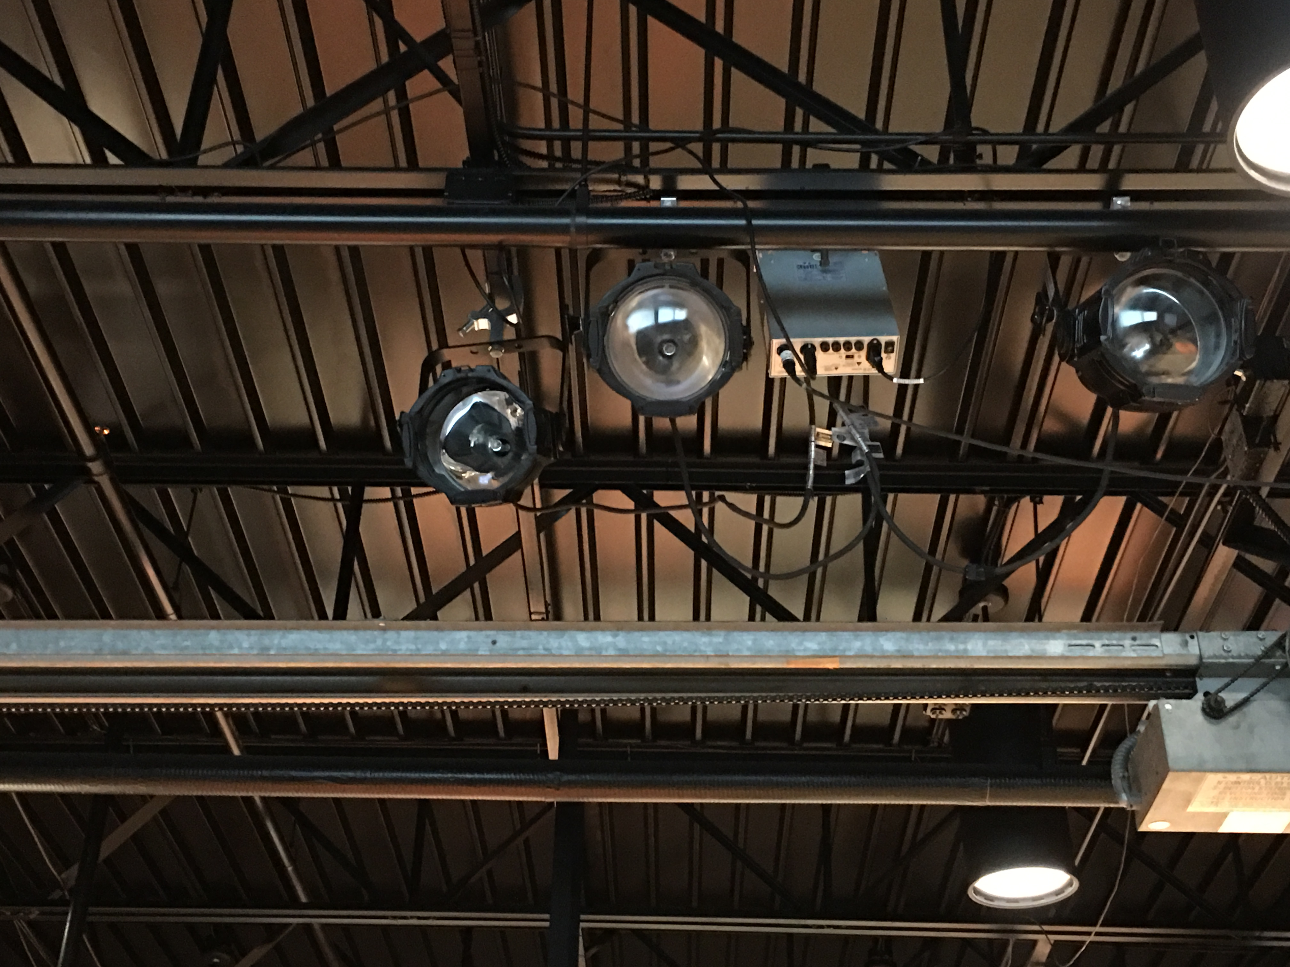

Slide 56
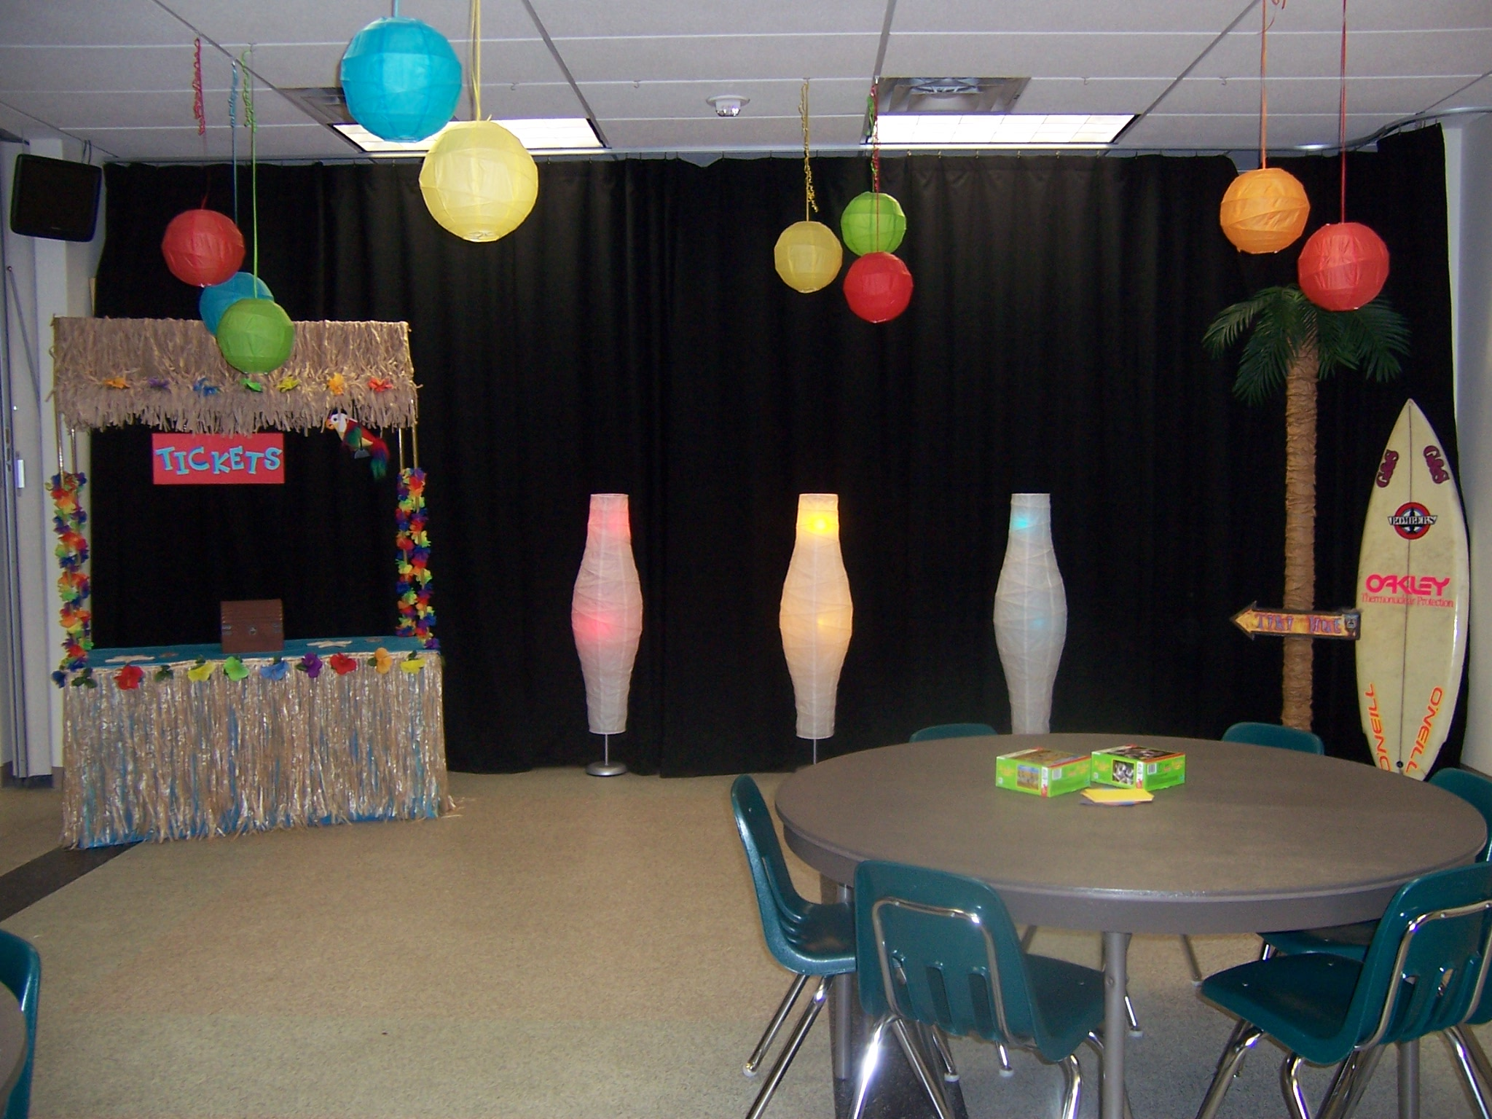

Slide 57
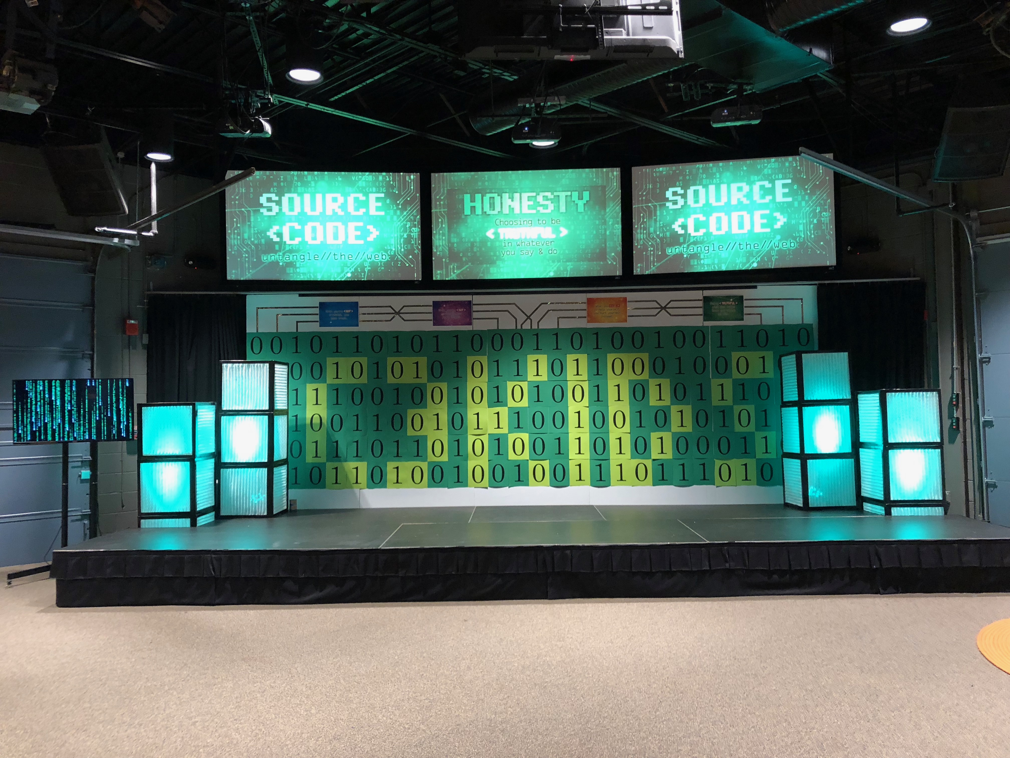
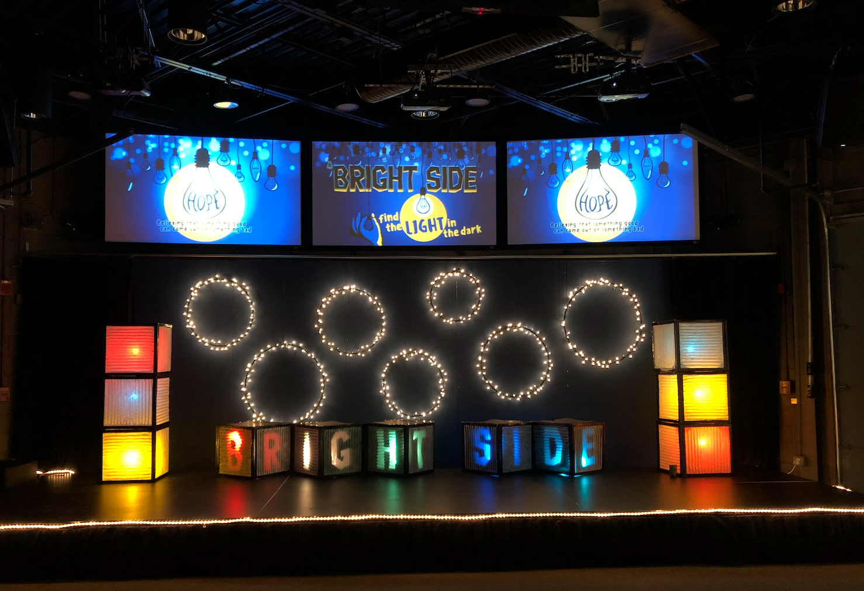
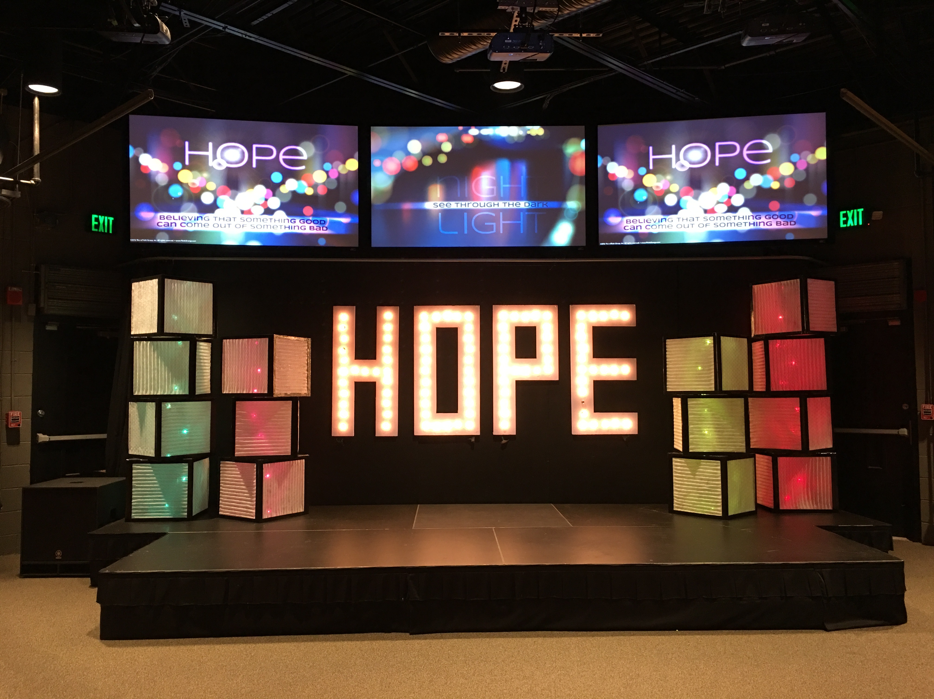

Slide 58
SHARED SPACE - PORTABILITY
Magnets/Command Hooks
Tracking system for focal wall
Frames w/ hinges
Hanging curtains
Movable signage

Slide 59
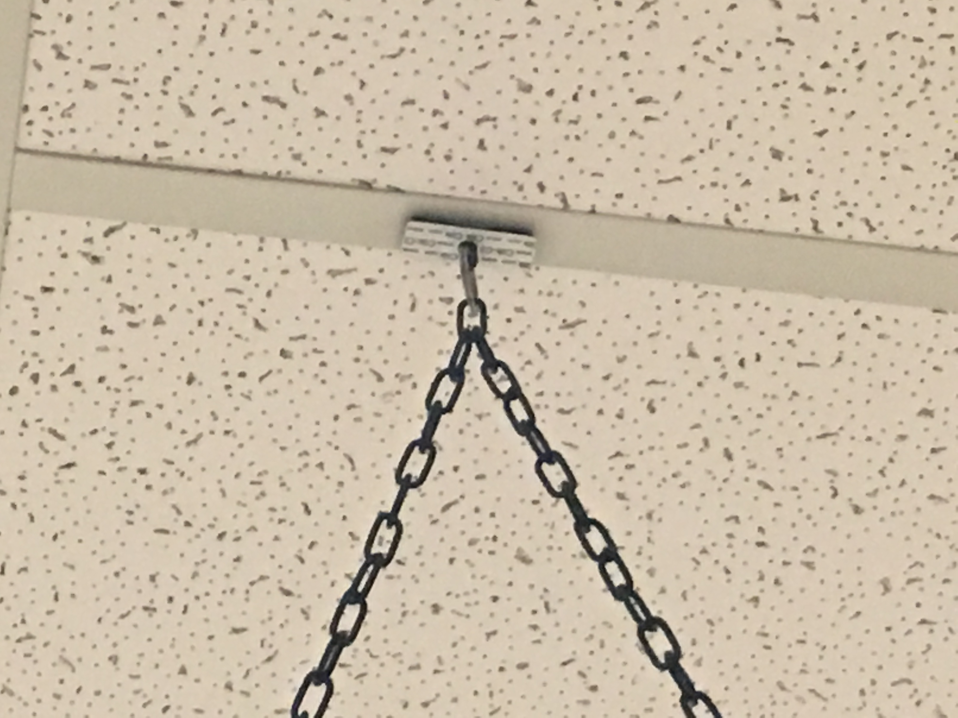
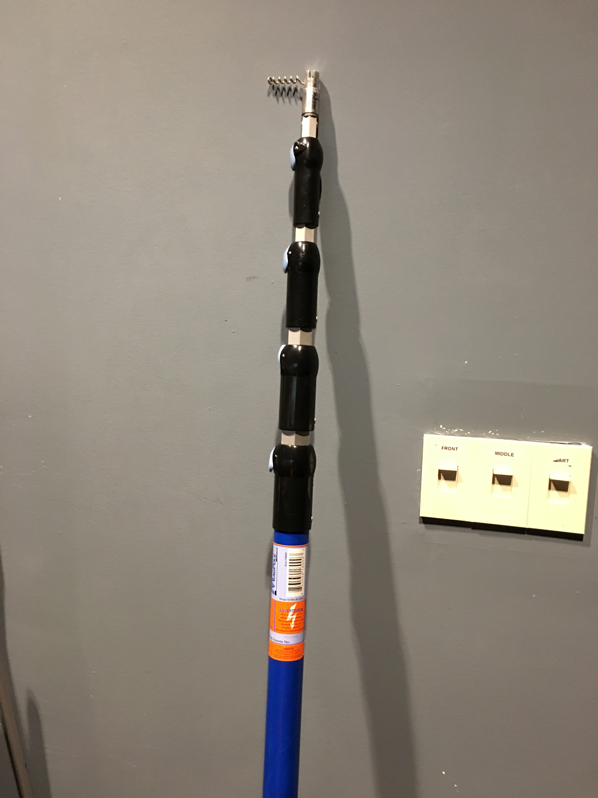

Slide 60
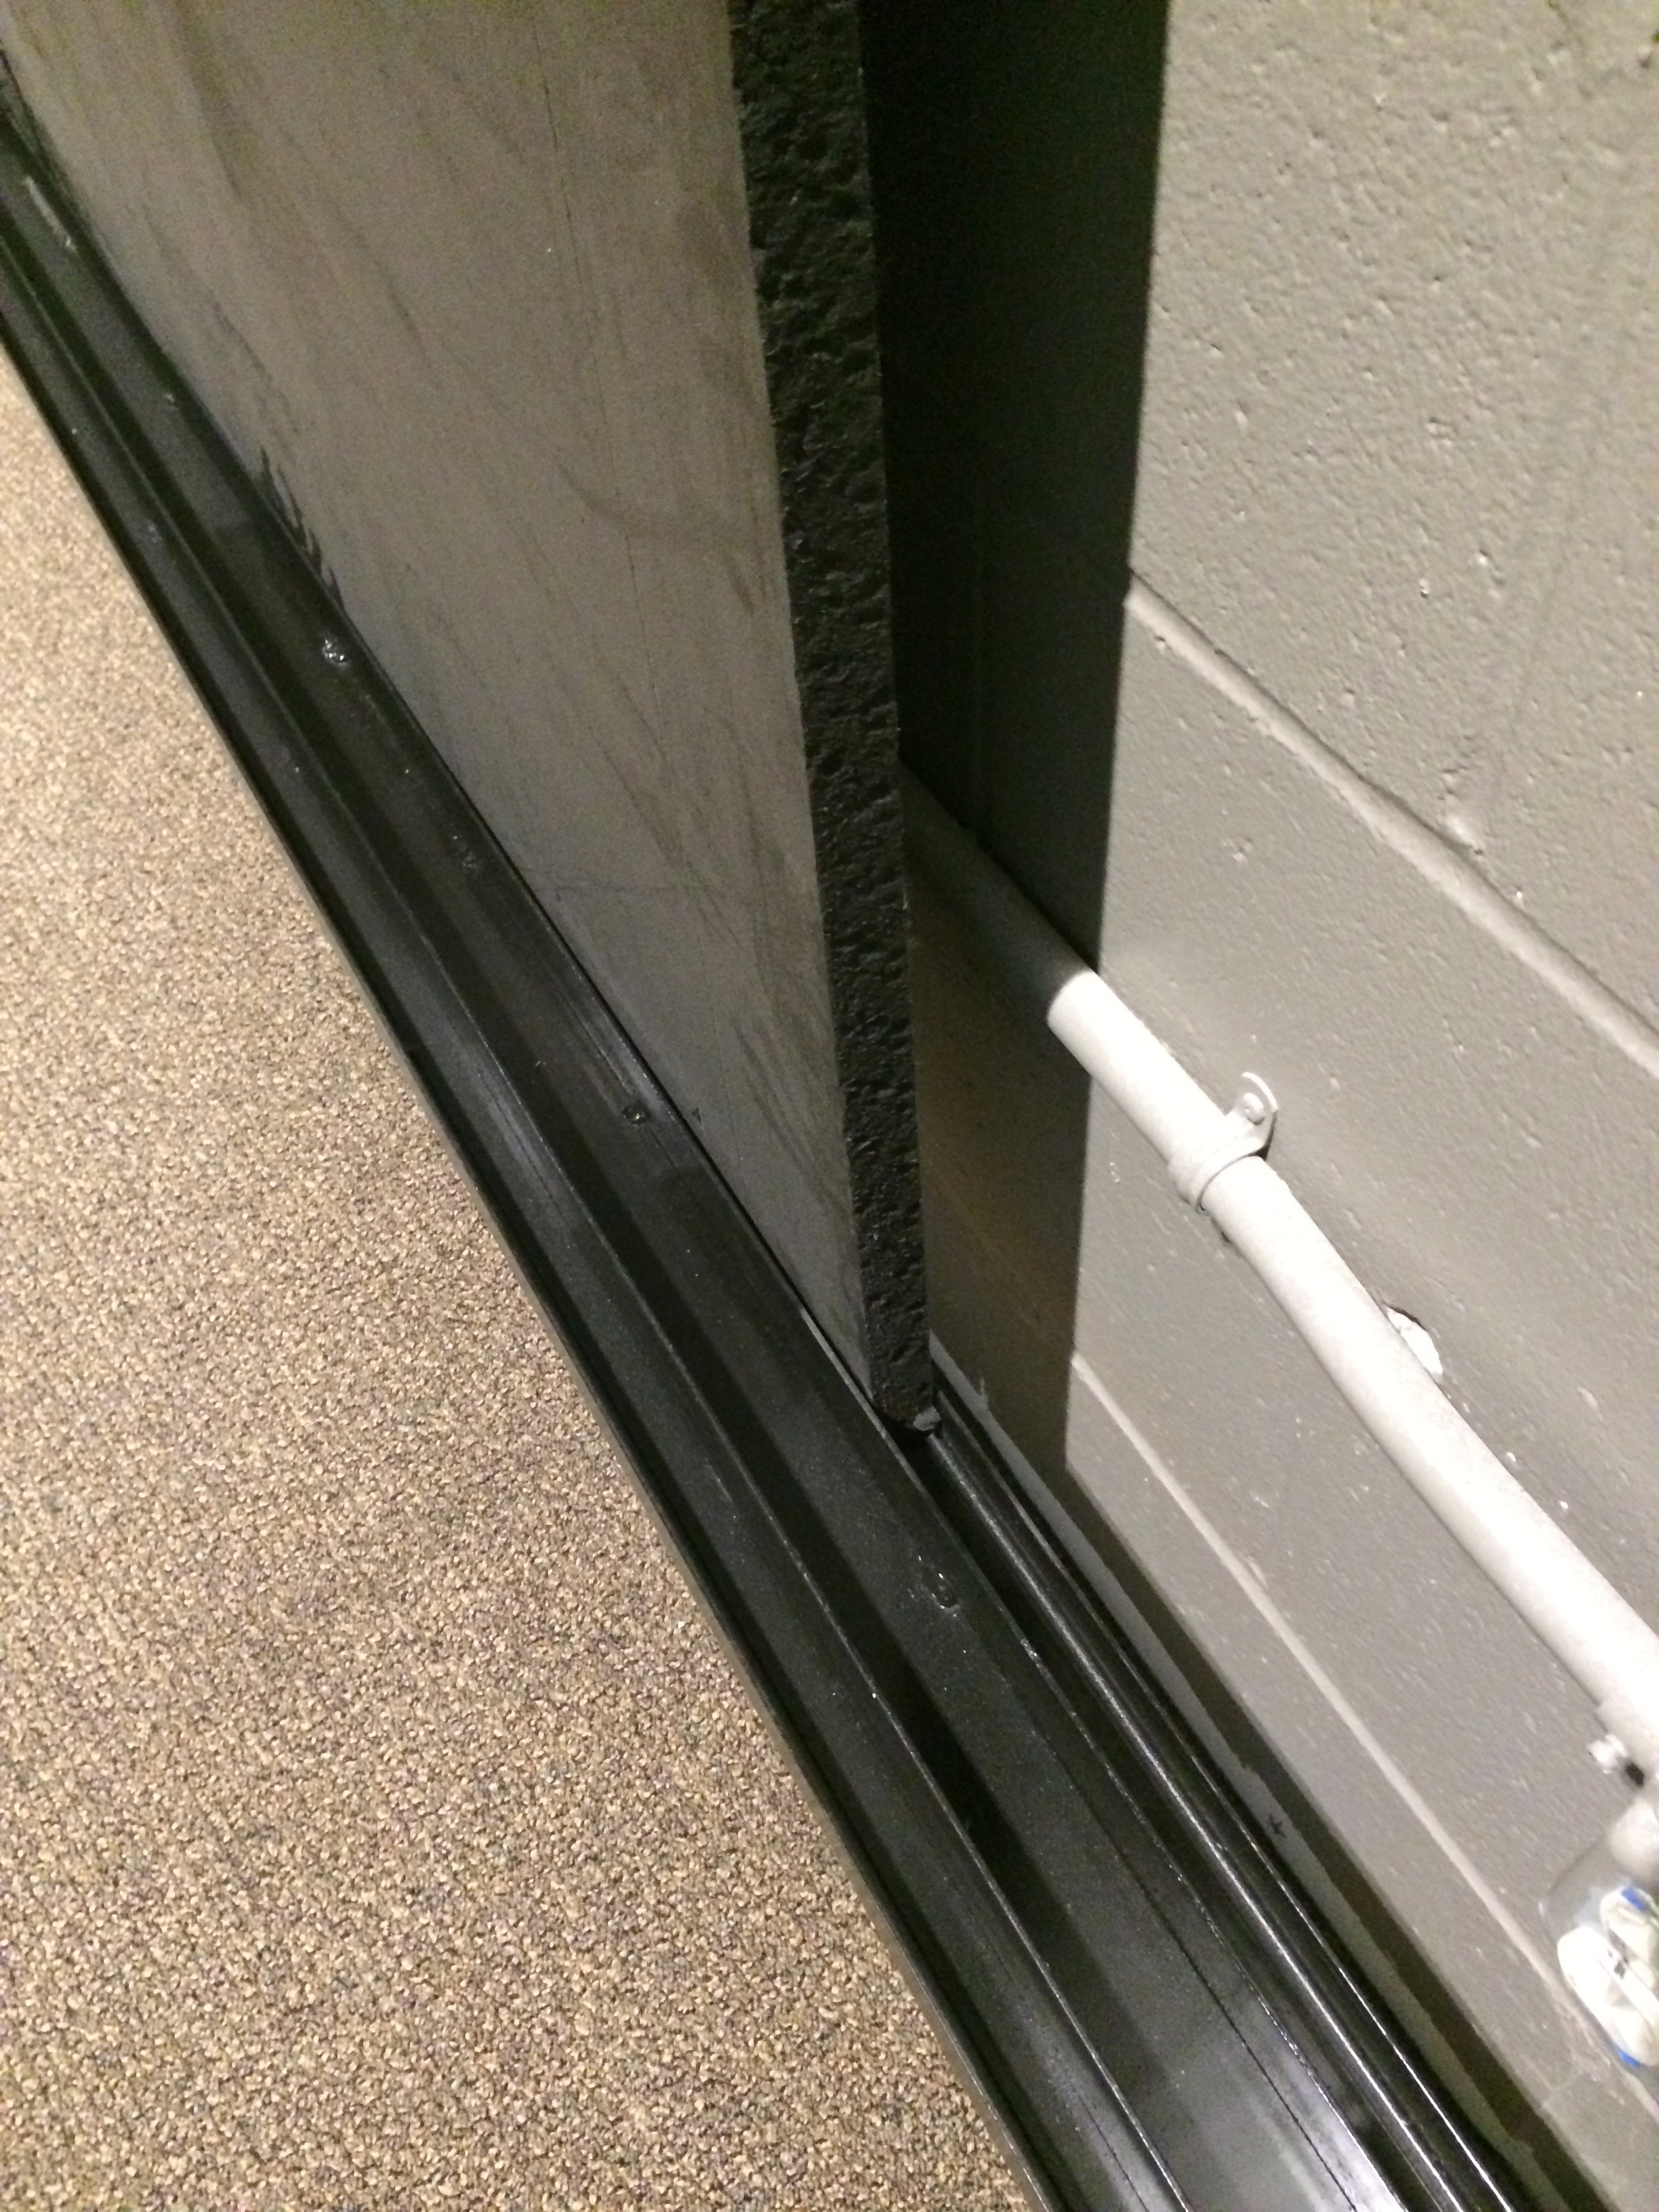
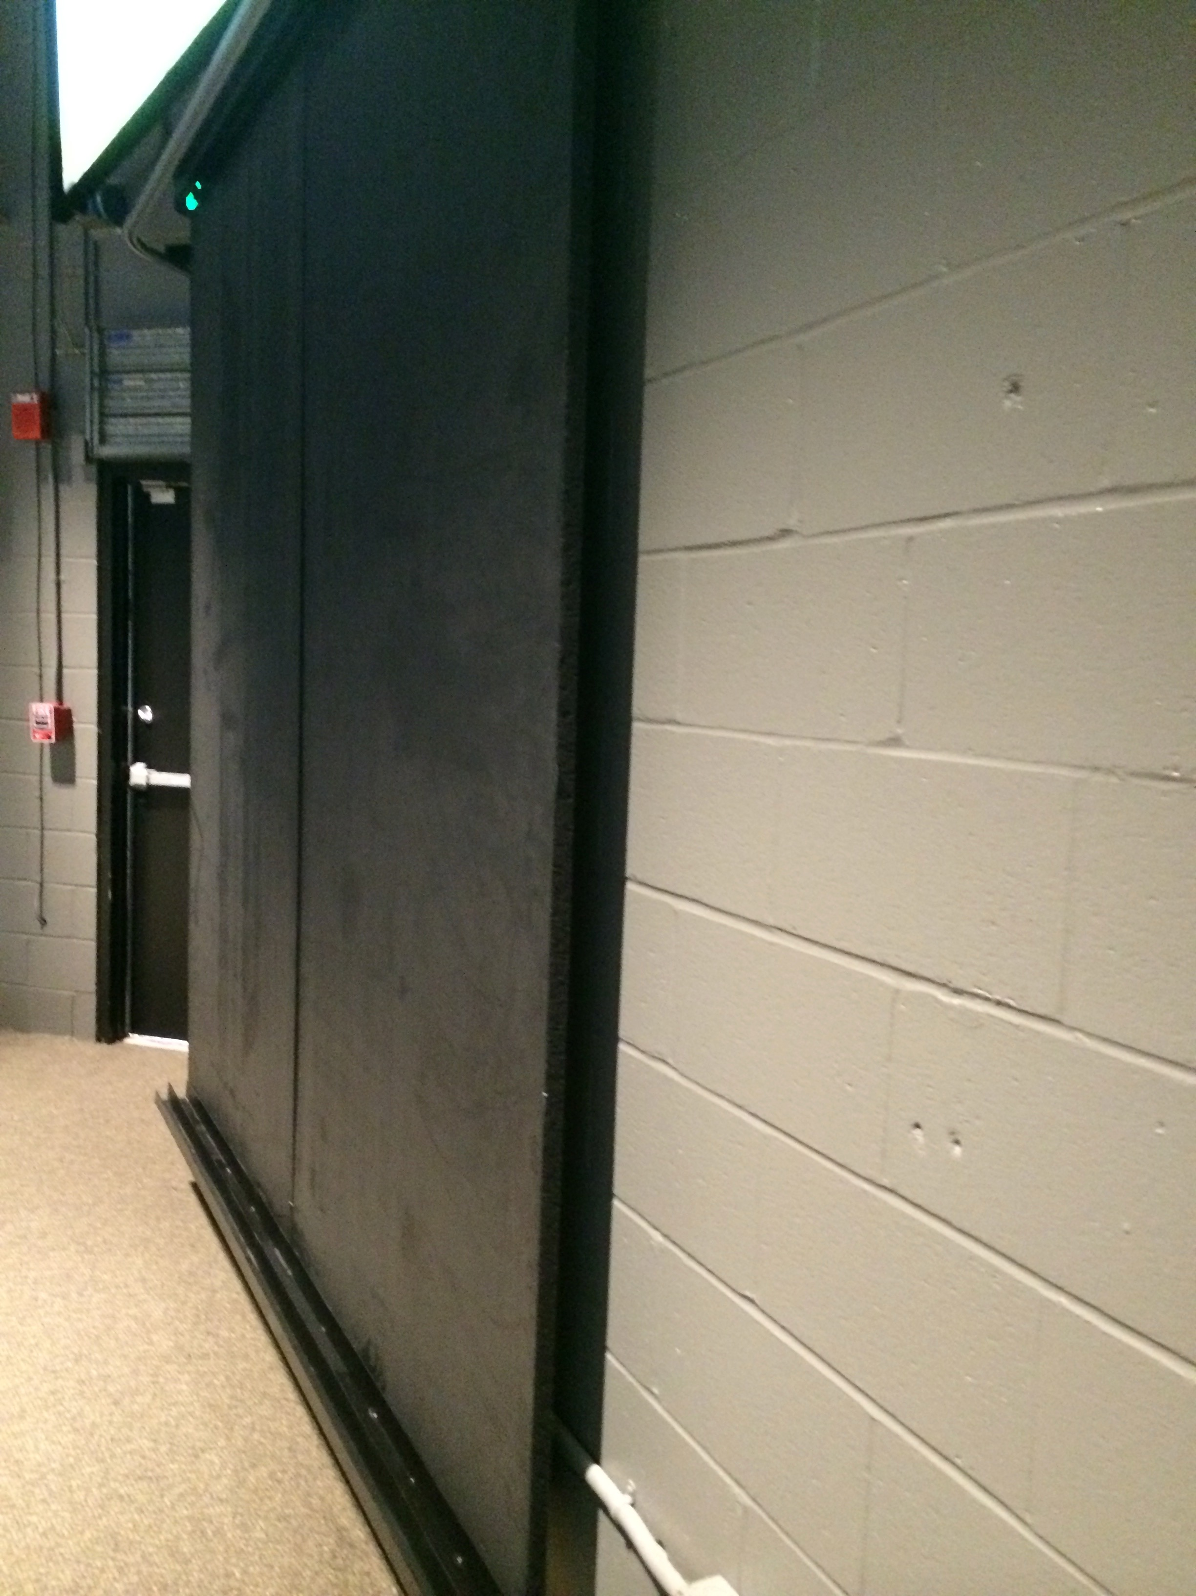

Slide 61
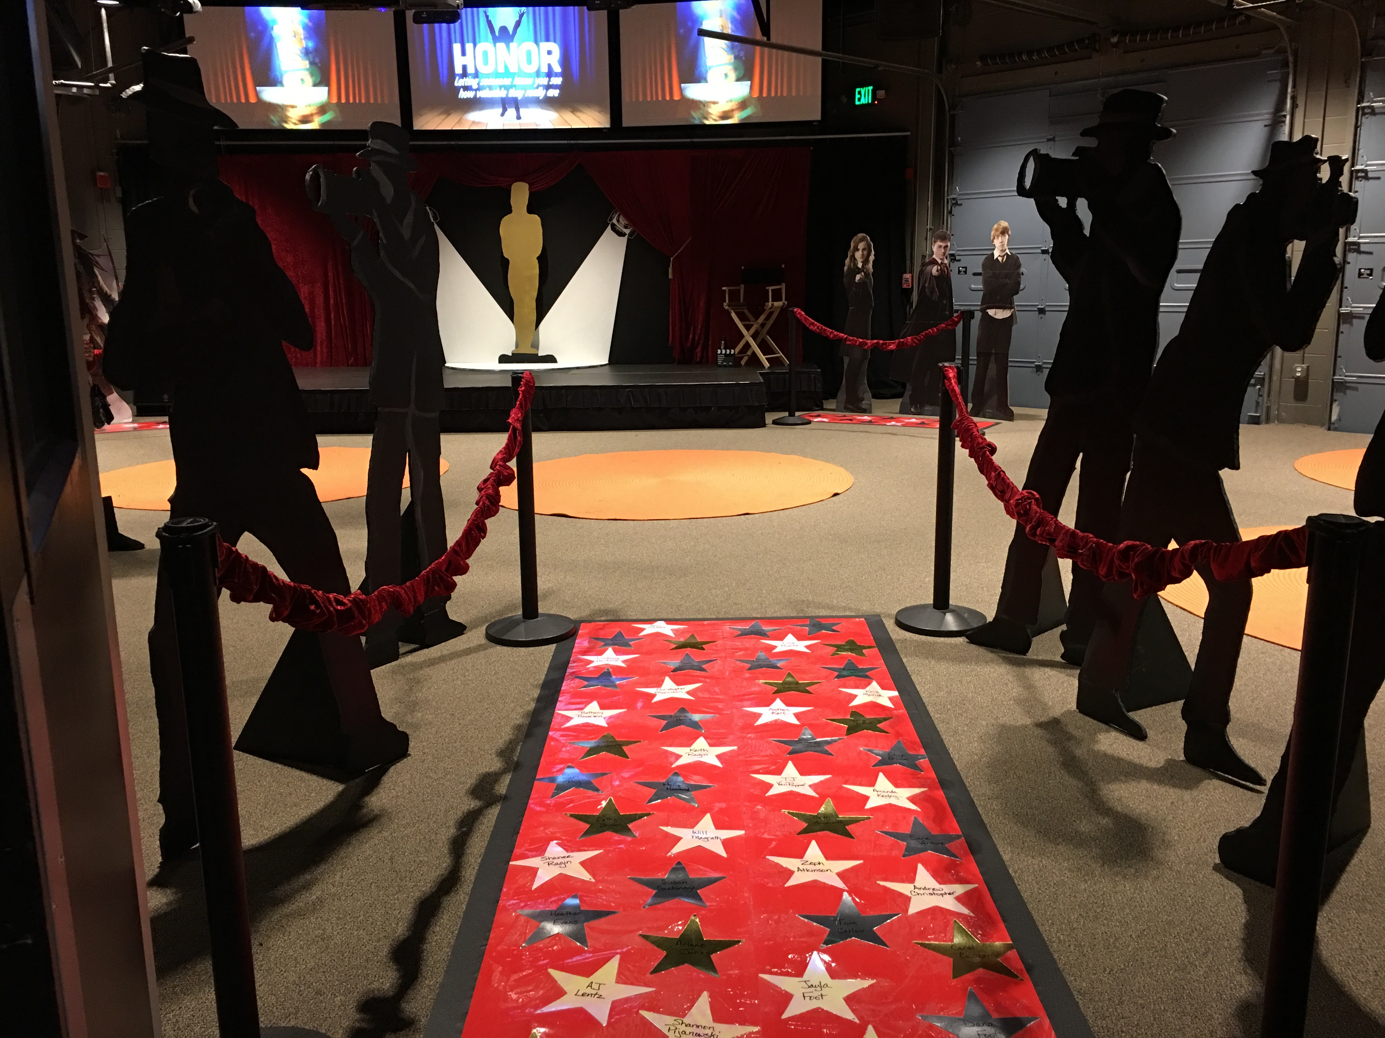

Slide 62
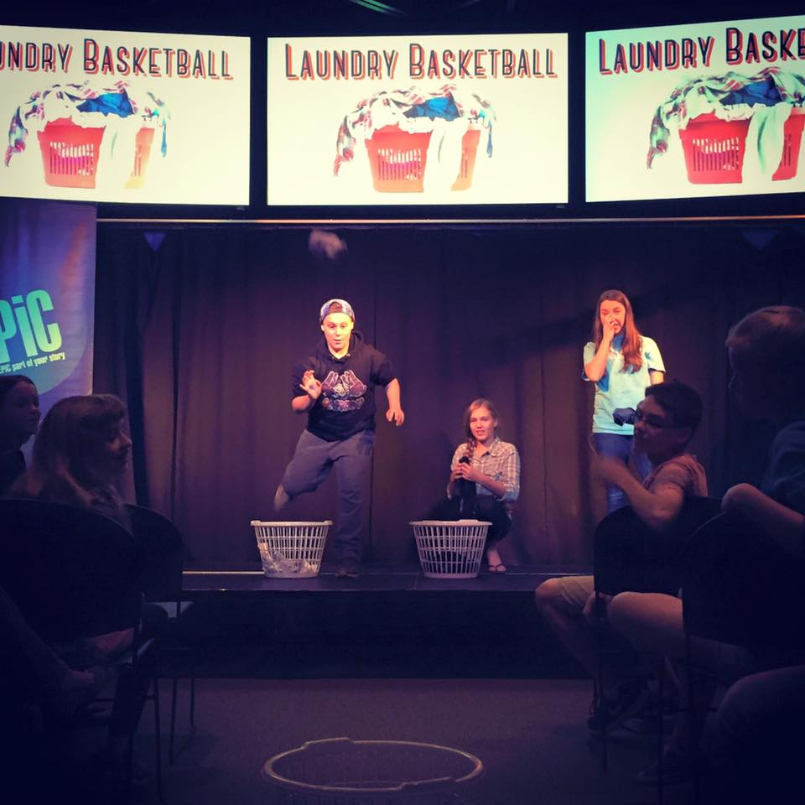
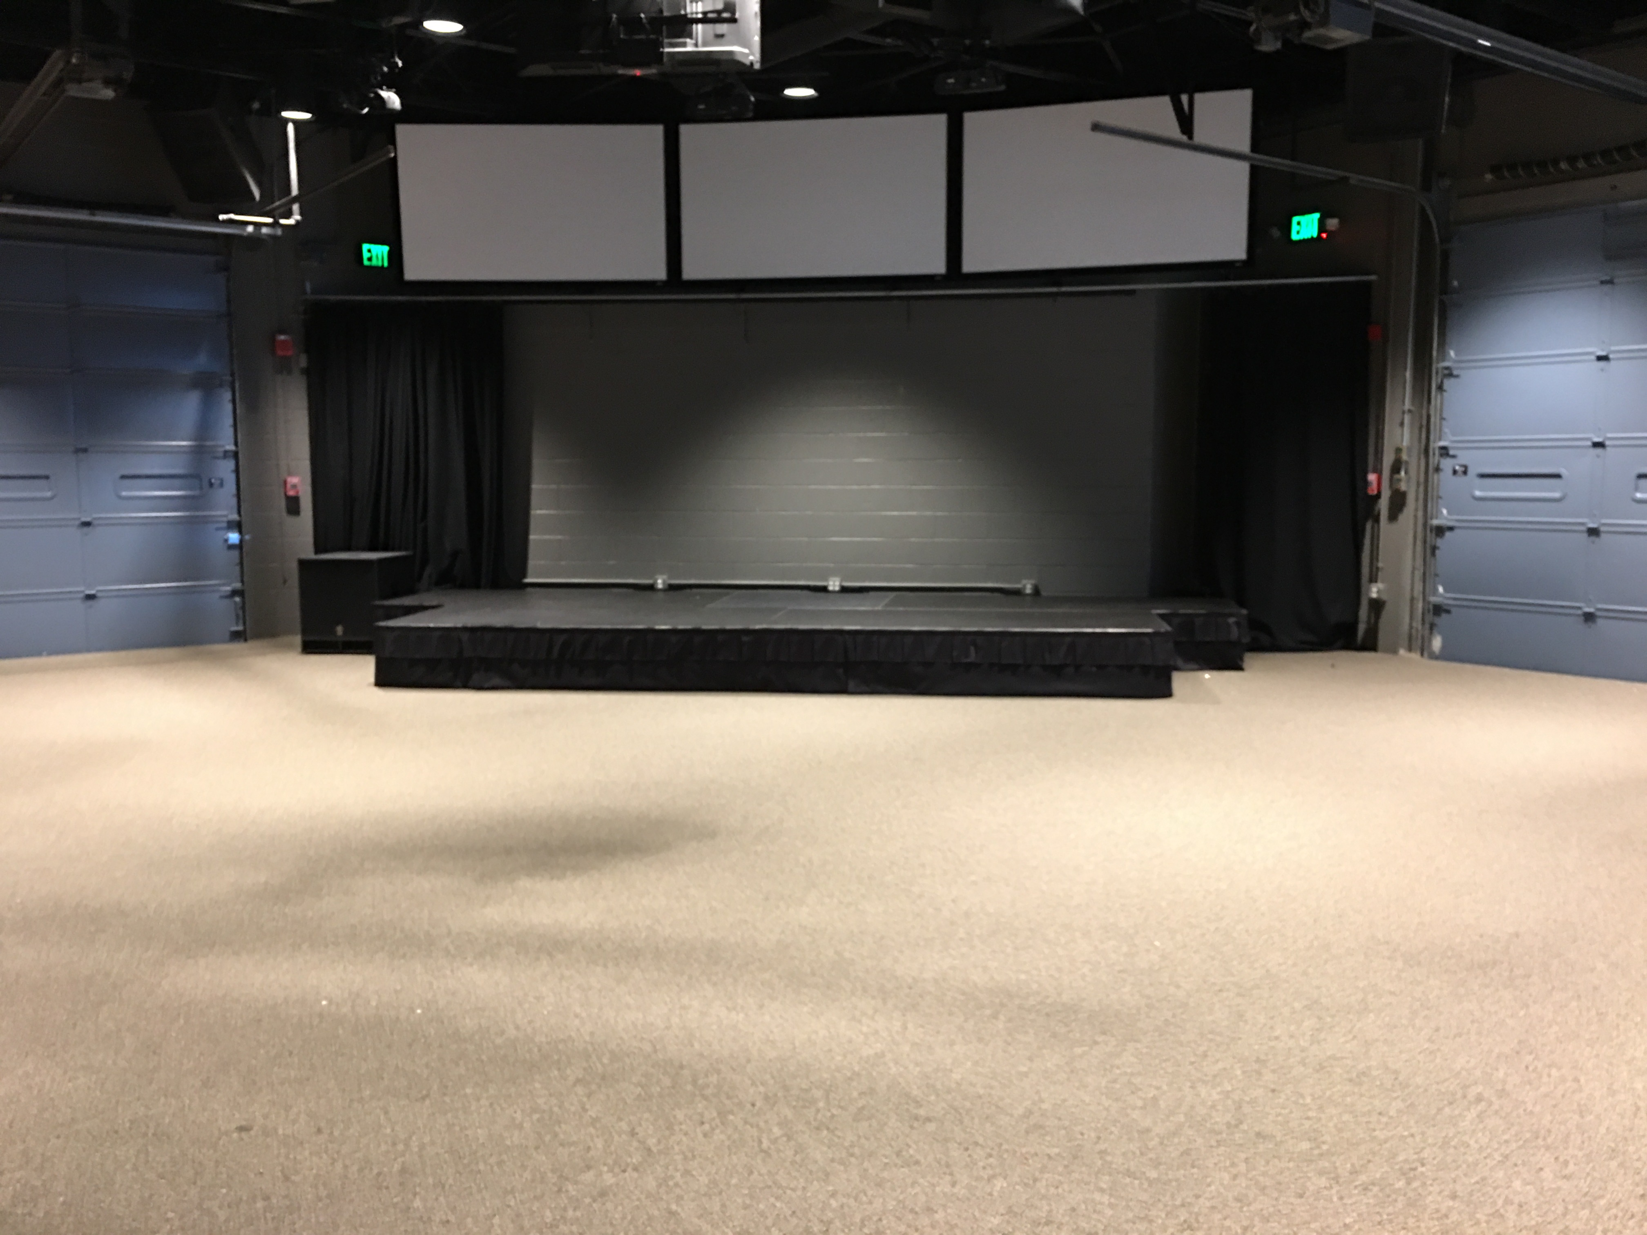
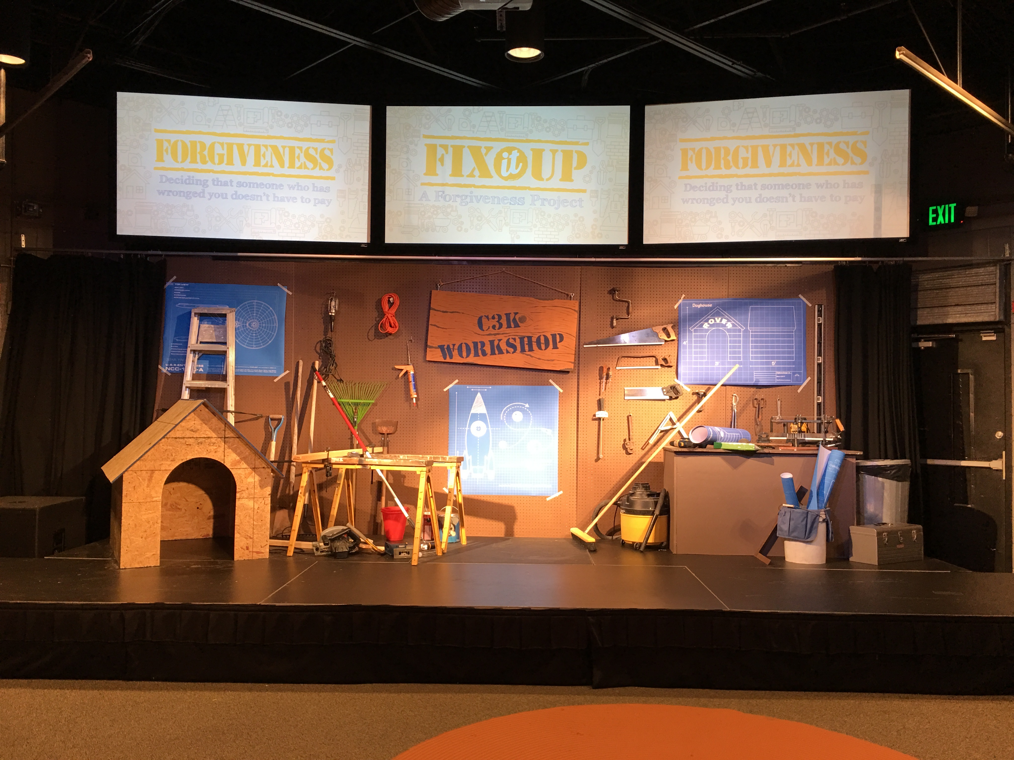

Slide 63
SHARED SPACE - STORAGE
Hanging curtains
Under the stage
My car, basement, garage!

Slide 64
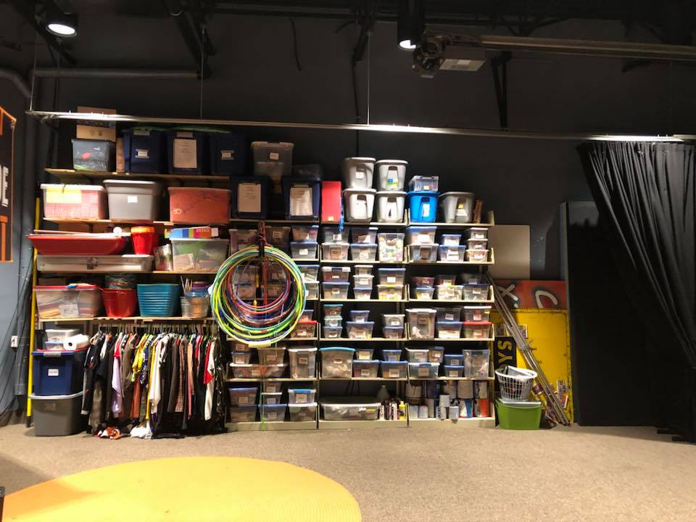
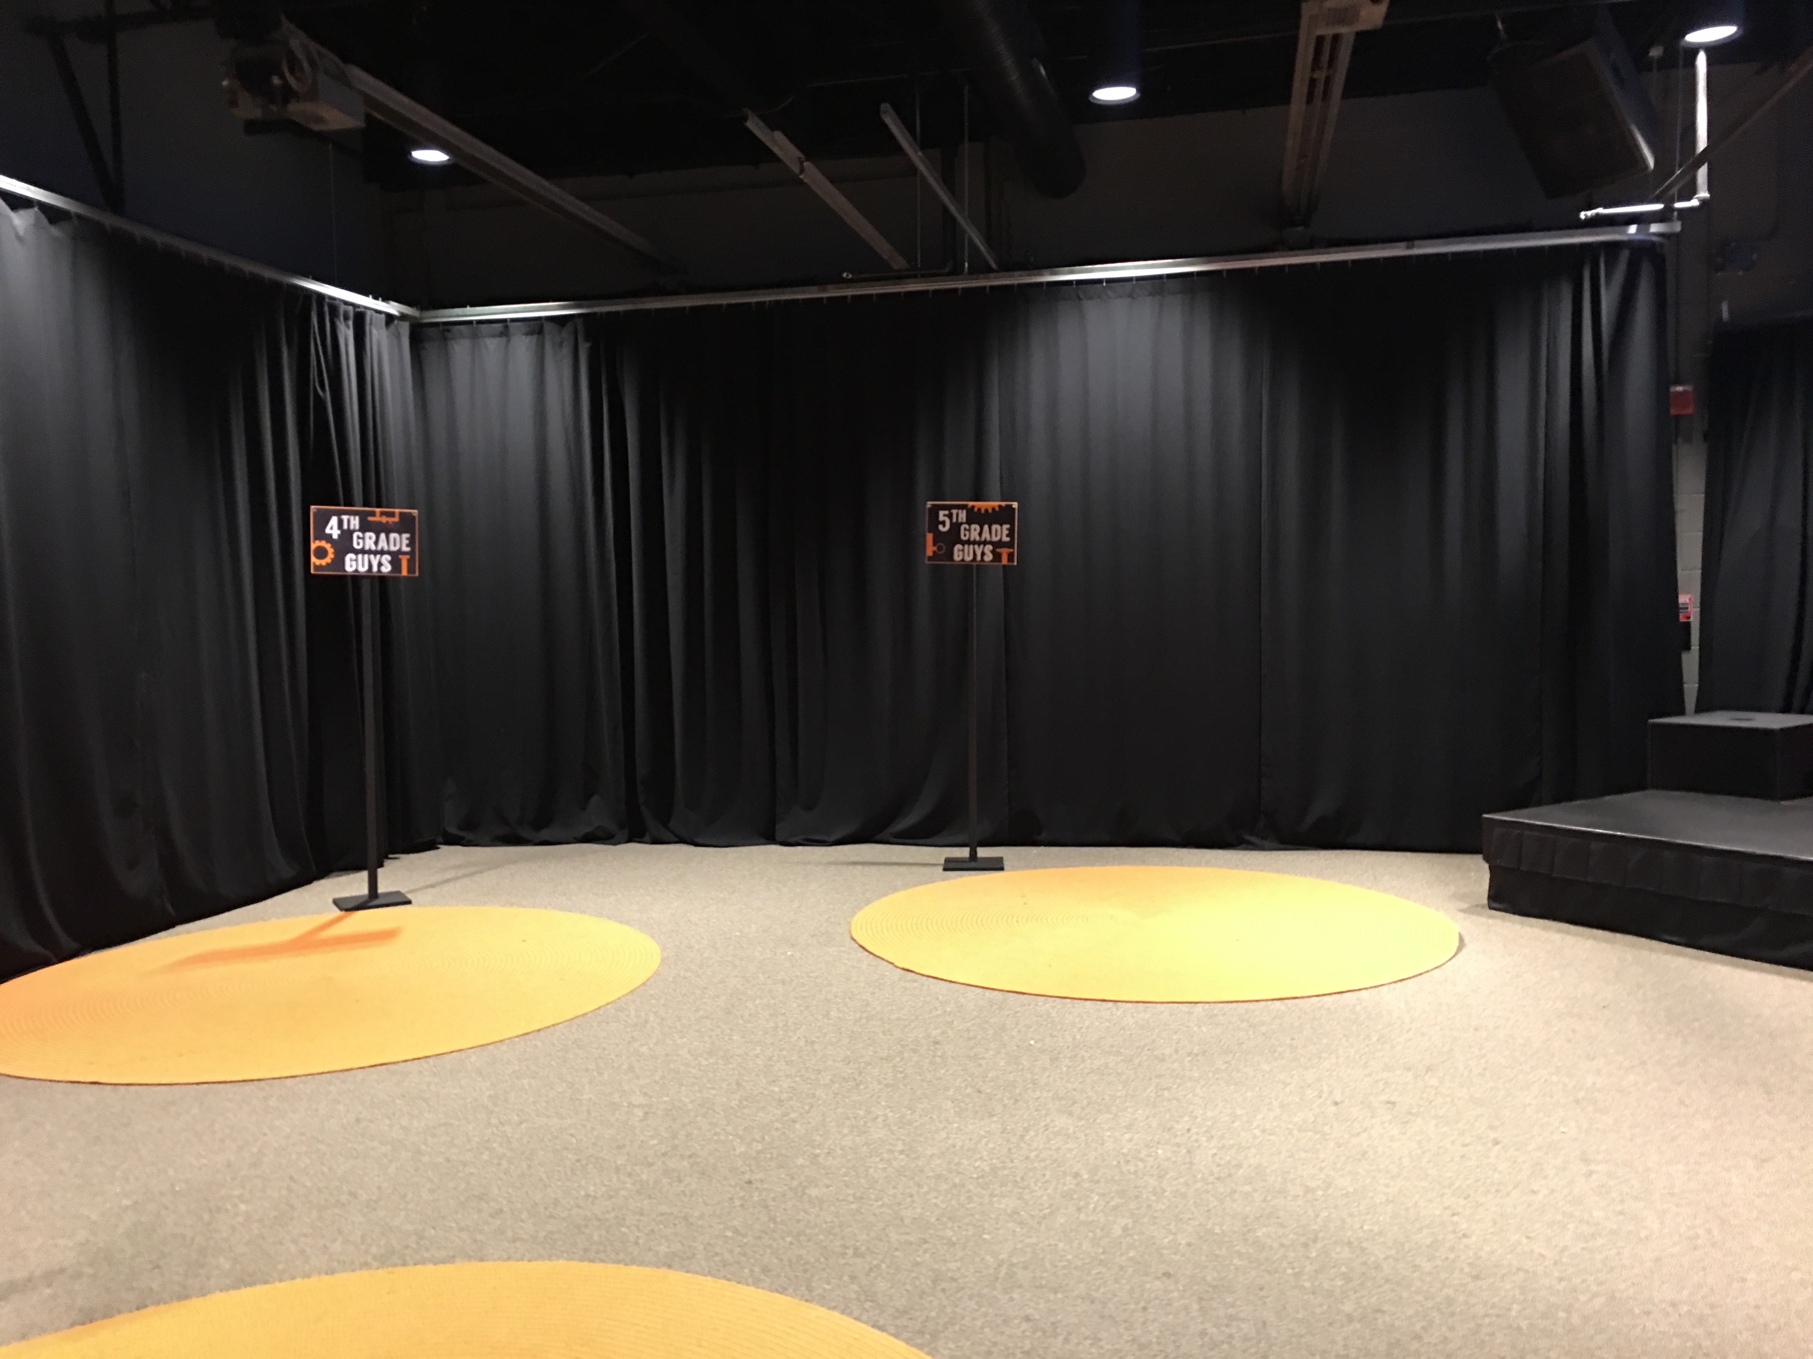

Slide 65
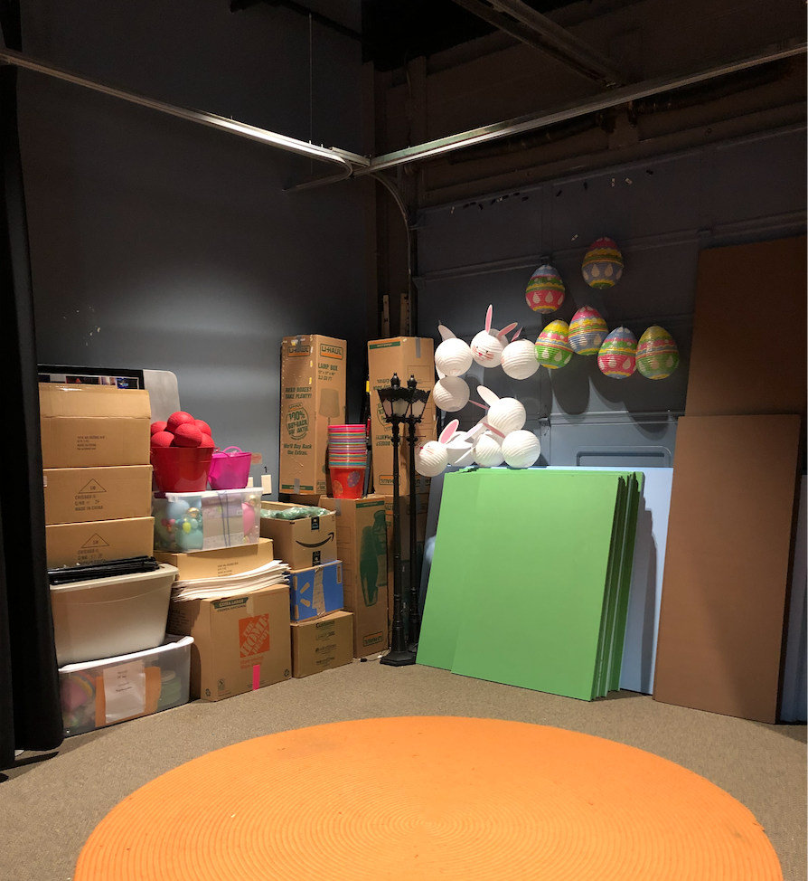
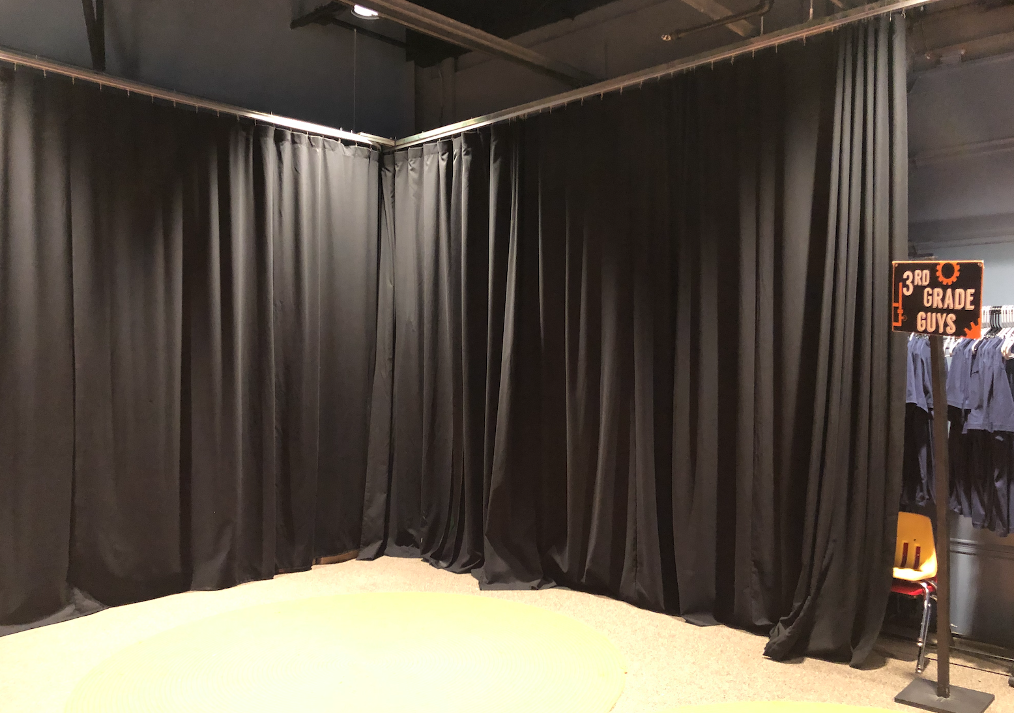

Slide 66
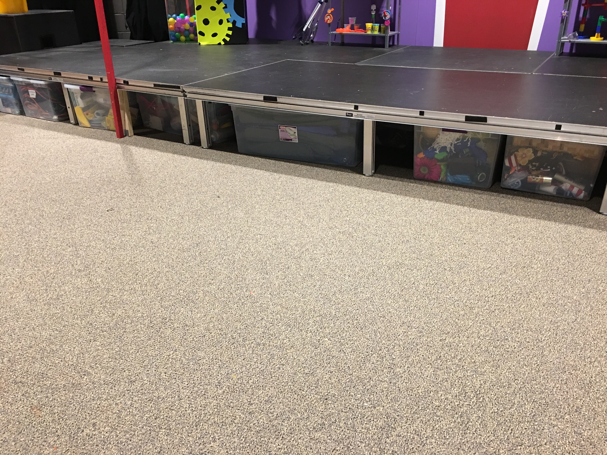
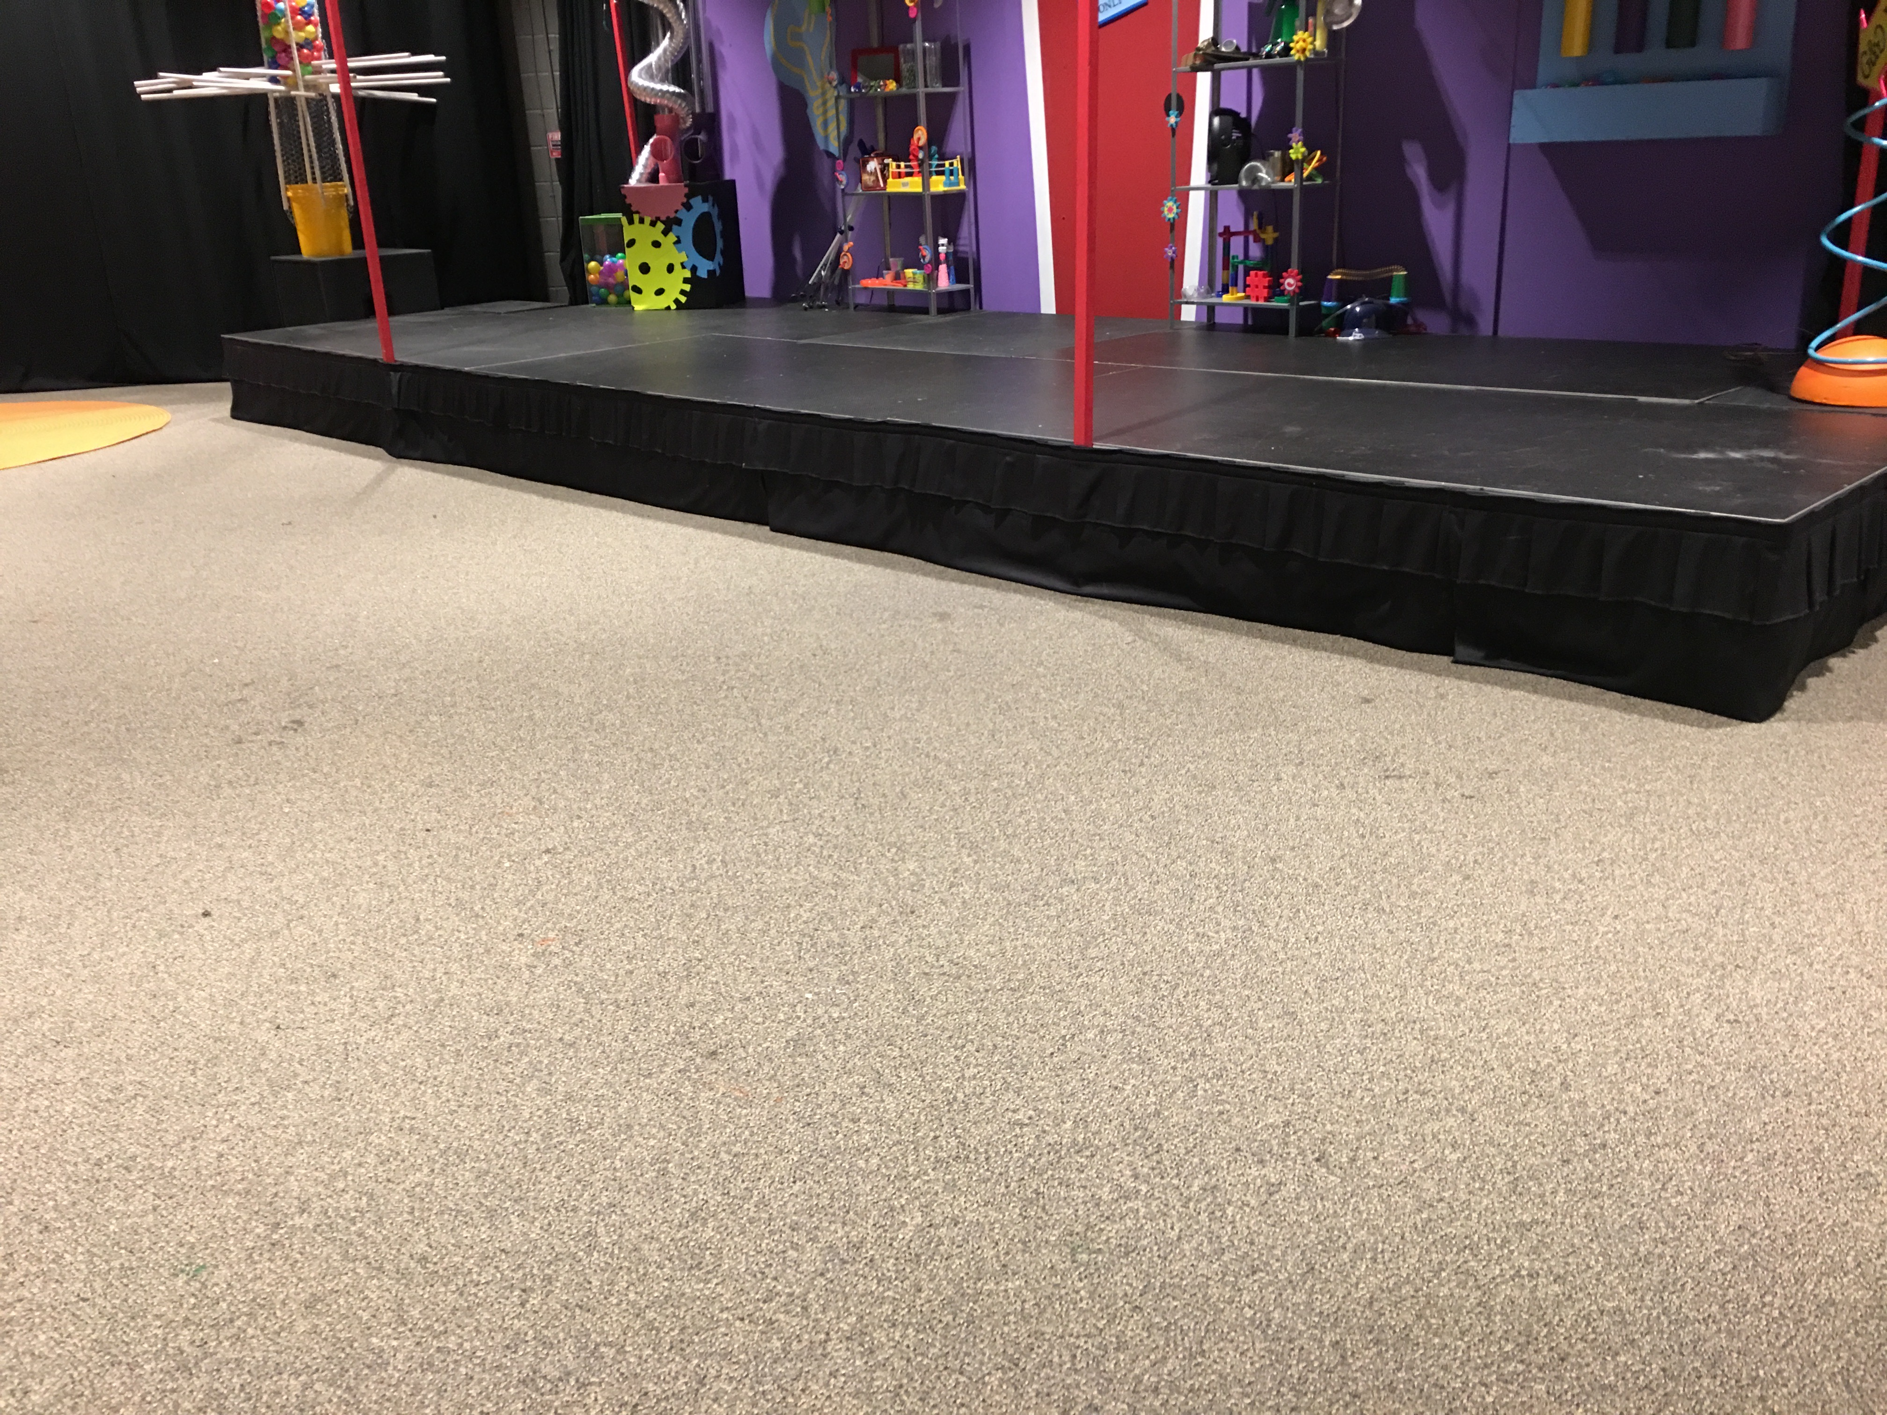

Slide 67
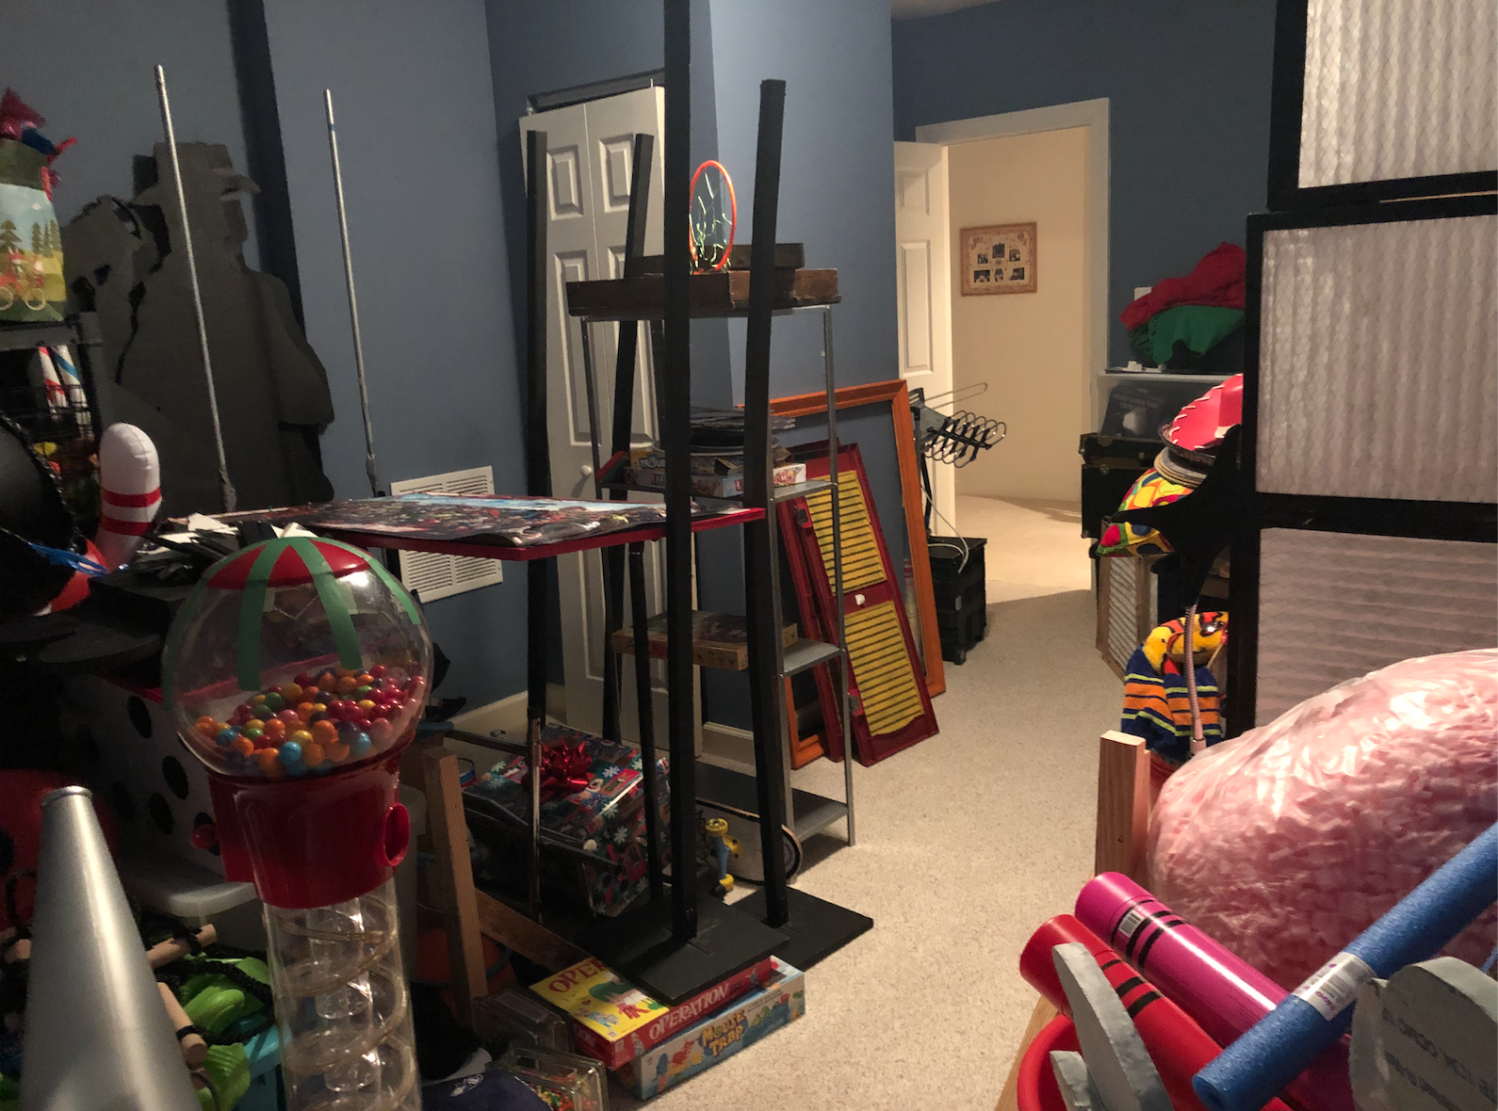

Slide 68
The goal of your physical environment is to create a space where relationships can thrive.

